Slide 1

Glenn Ross-Dolan
M.Sc. Bioinformatics and Computational Biology
“Identifying epithelial cell subsets and pathways altered in the intestine of subjects with obesity and diabetes”
Supervised By:
Silvia Melgar

Slide 2
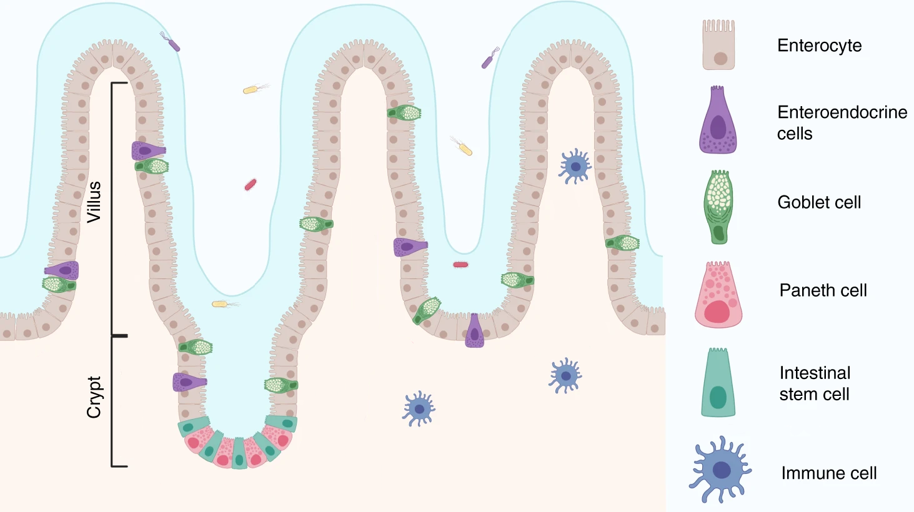
Project Aim
Find altered genes/pathways in the individual intestinal cell types which are characteristic of the T2DM subject.
Intestinal Epithelium
Why?
Complement of Bastian’s Study
Allows him to select biological targets for further study in the seaweed experiments.
Image adapted from: https://www.nature.com/articles/s41467-020-20052-z/figures/1

Slide 3
Choose suitable data ✅
Review literature for best analysis practices ✅
Build an analysis pipeline ✅
Carry out the analysis ✅
Review the findings ✅
Form a biological hypothesis ⌛
Build onto the current literature ⌛
How?

Slide 4
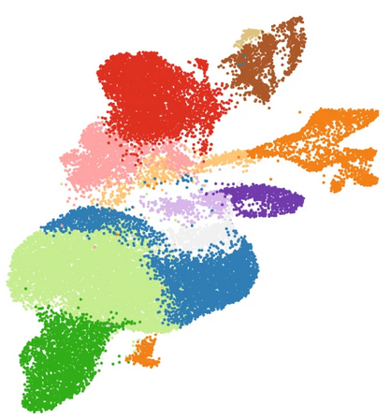
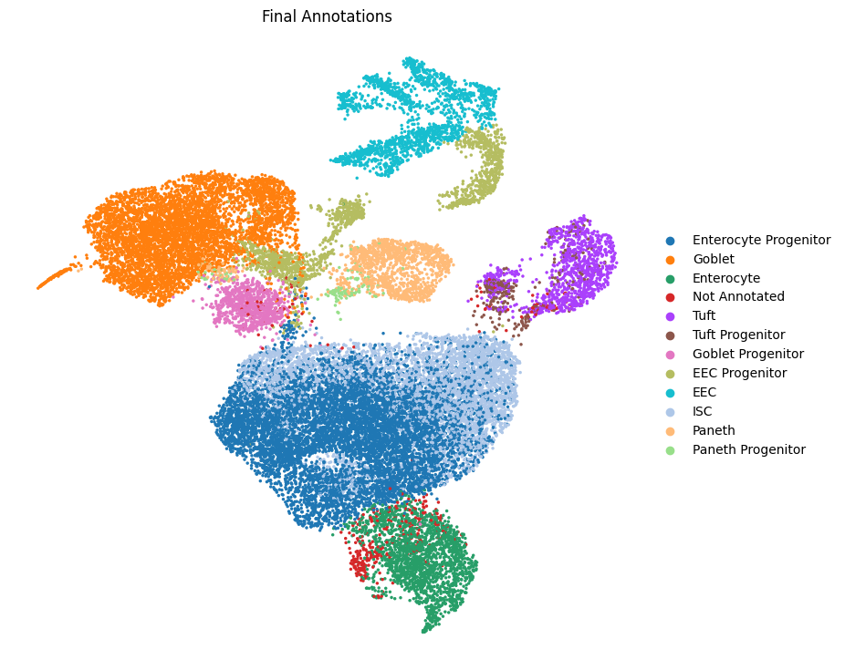
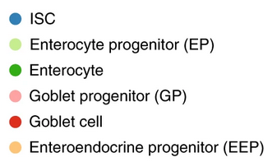
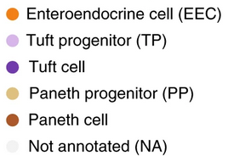
Annotated Dataset
(Intestinal Crypts)

Slide 5
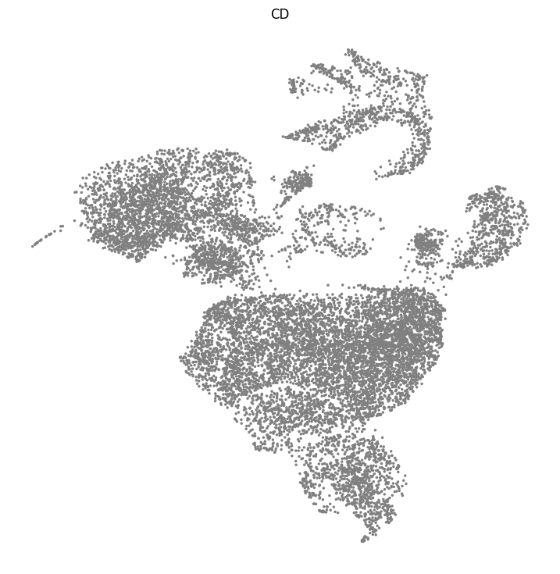
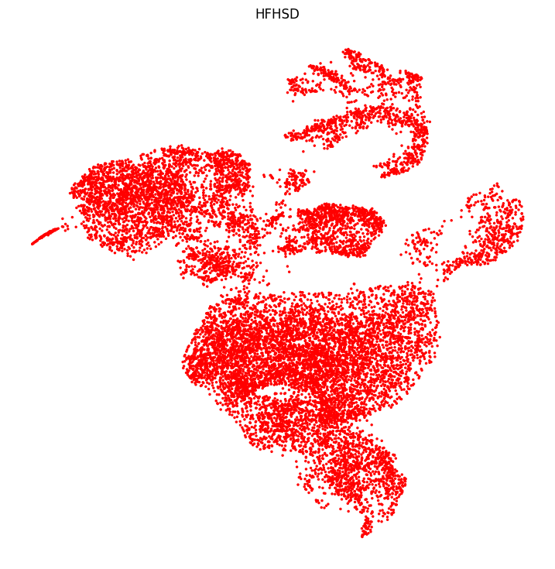
UMAP by Diet - Crypt Enriched Dataset

Slide 6
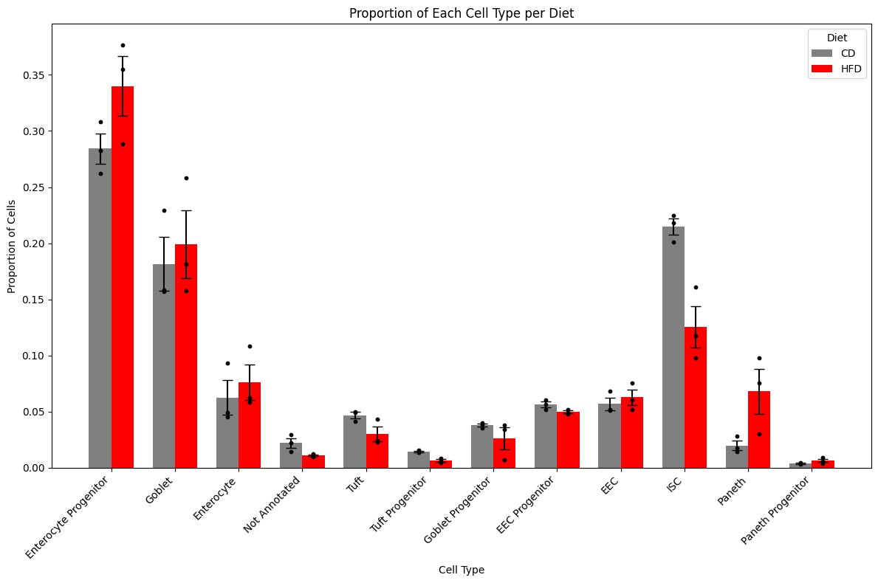
Cell Type Composition CD vs HFHSD

Slide 7
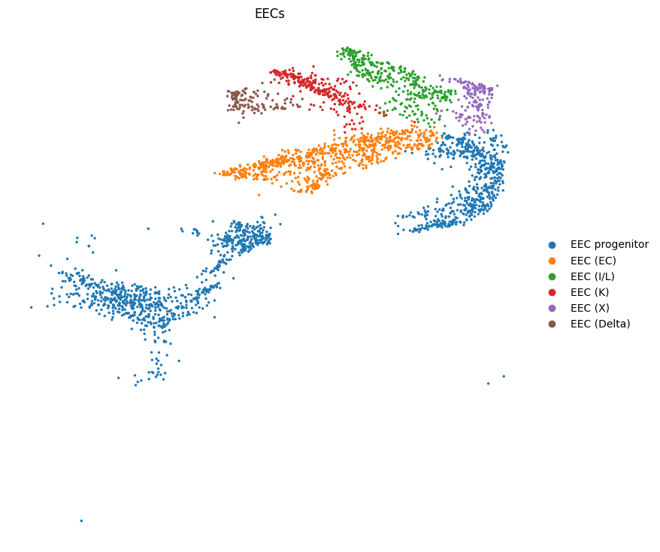
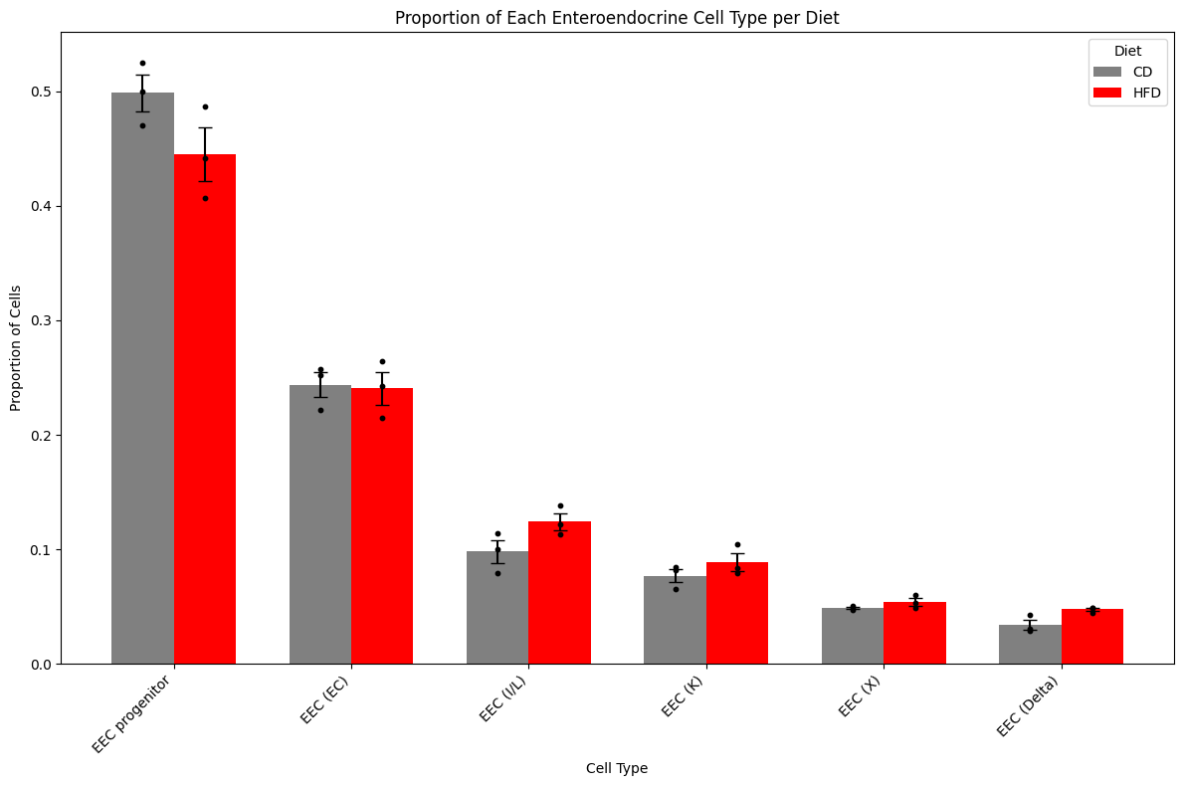

Slide 8
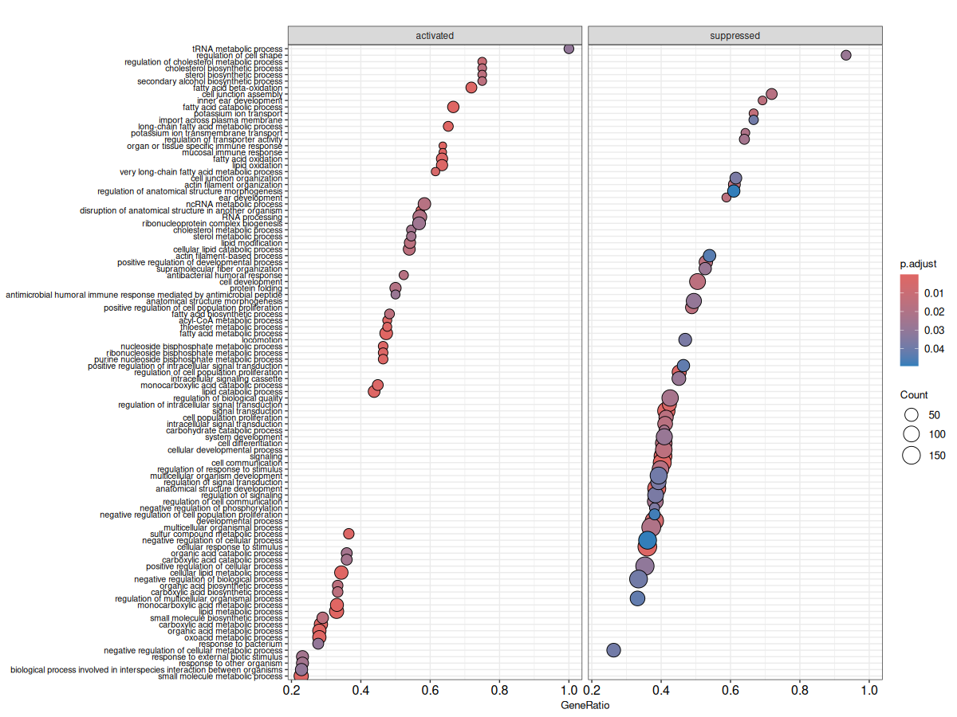
Gene Ontology Enrichment Analysis - ENT BP

Slide 9
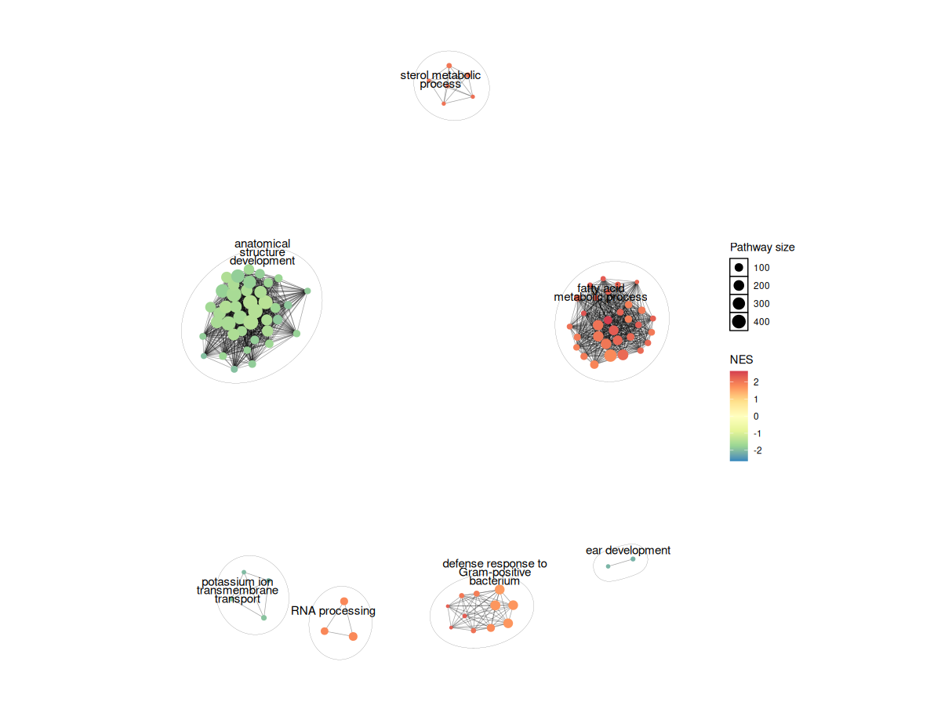
Gene Ontology Enrichment Analysis - ENT BP

Slide 10
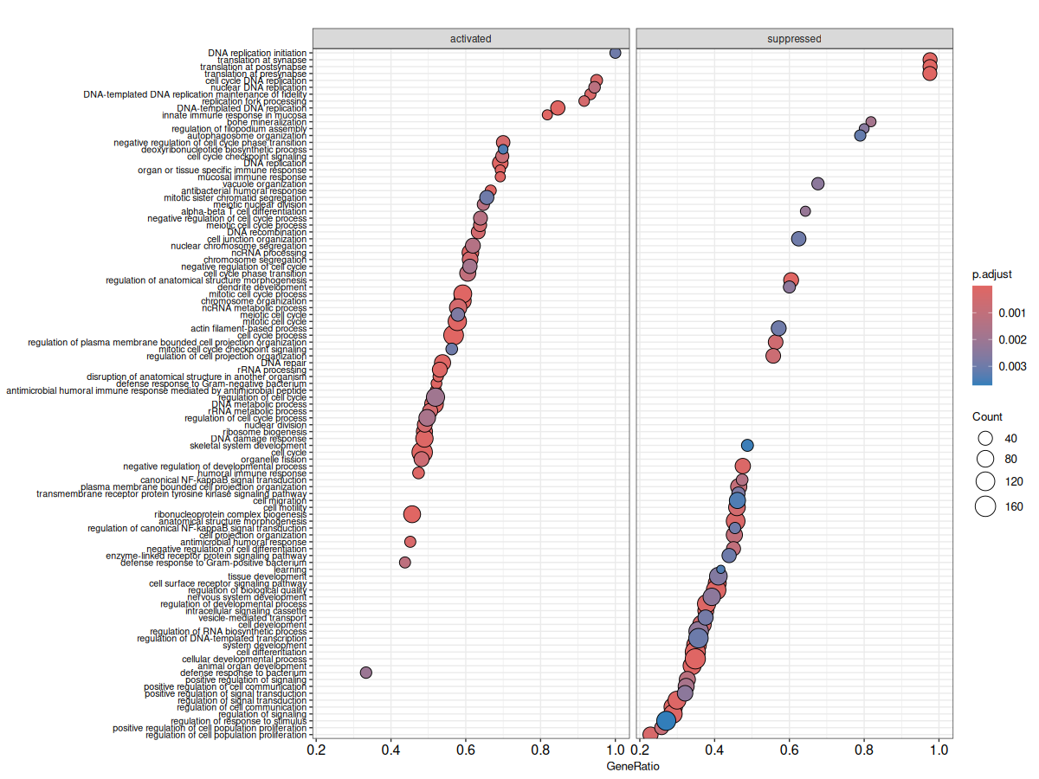
Gene Ontology Enrichment Analysis - ISC BP

Slide 11
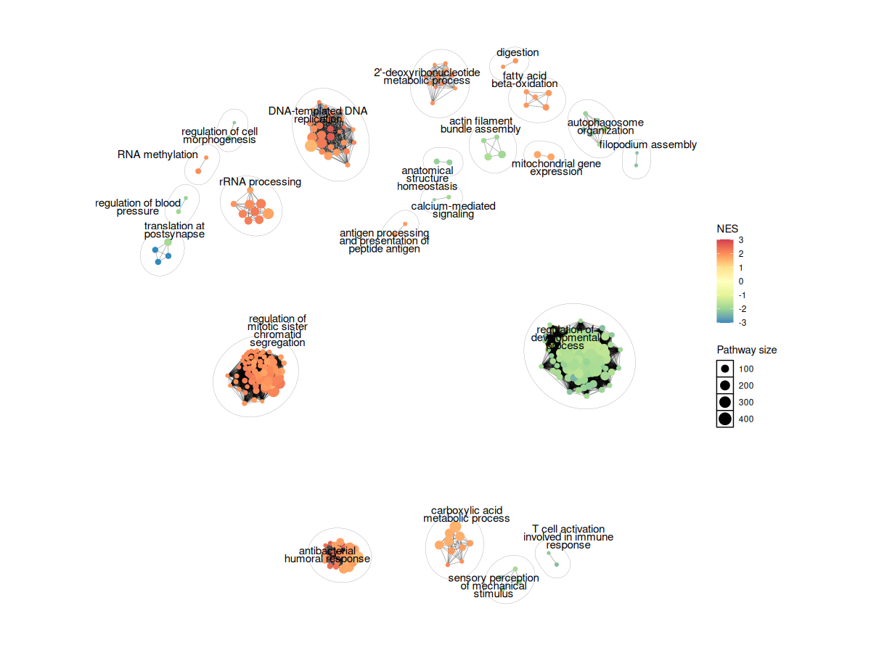
Gene Ontology Enrichment Analysis - ISC BP

Slide 12
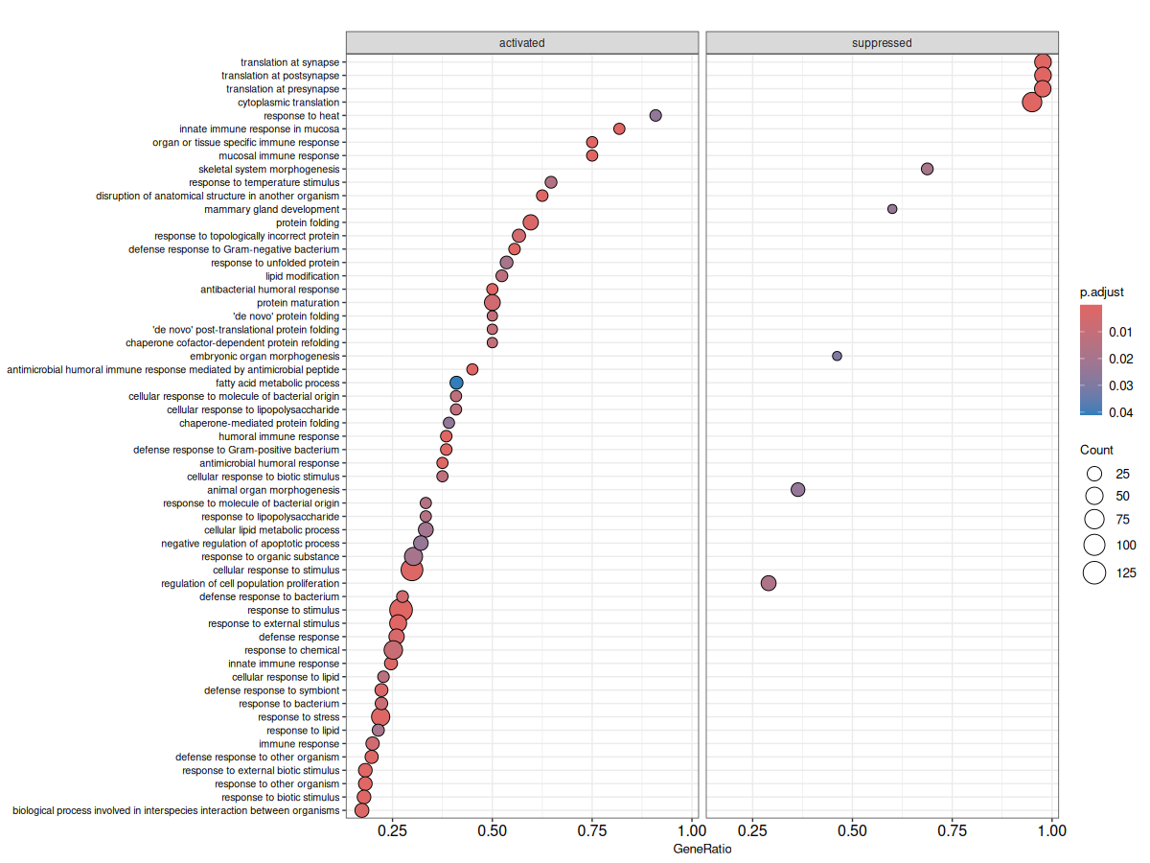
Gene Ontology Enrichment Analysis - GOB BP

Slide 13
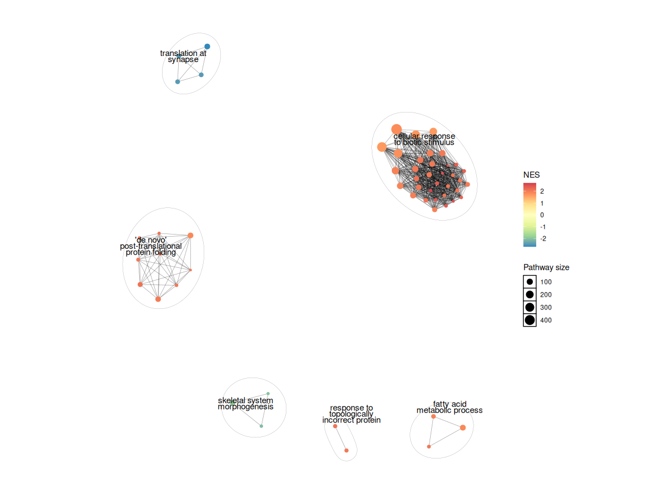
Gene Ontology Enrichment Analysis - GOB - BP

Slide 14
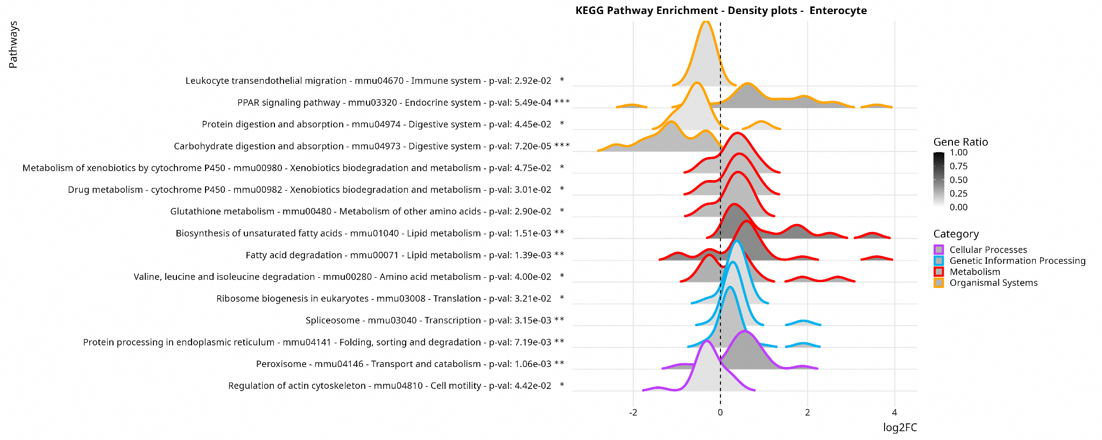

Slide 15
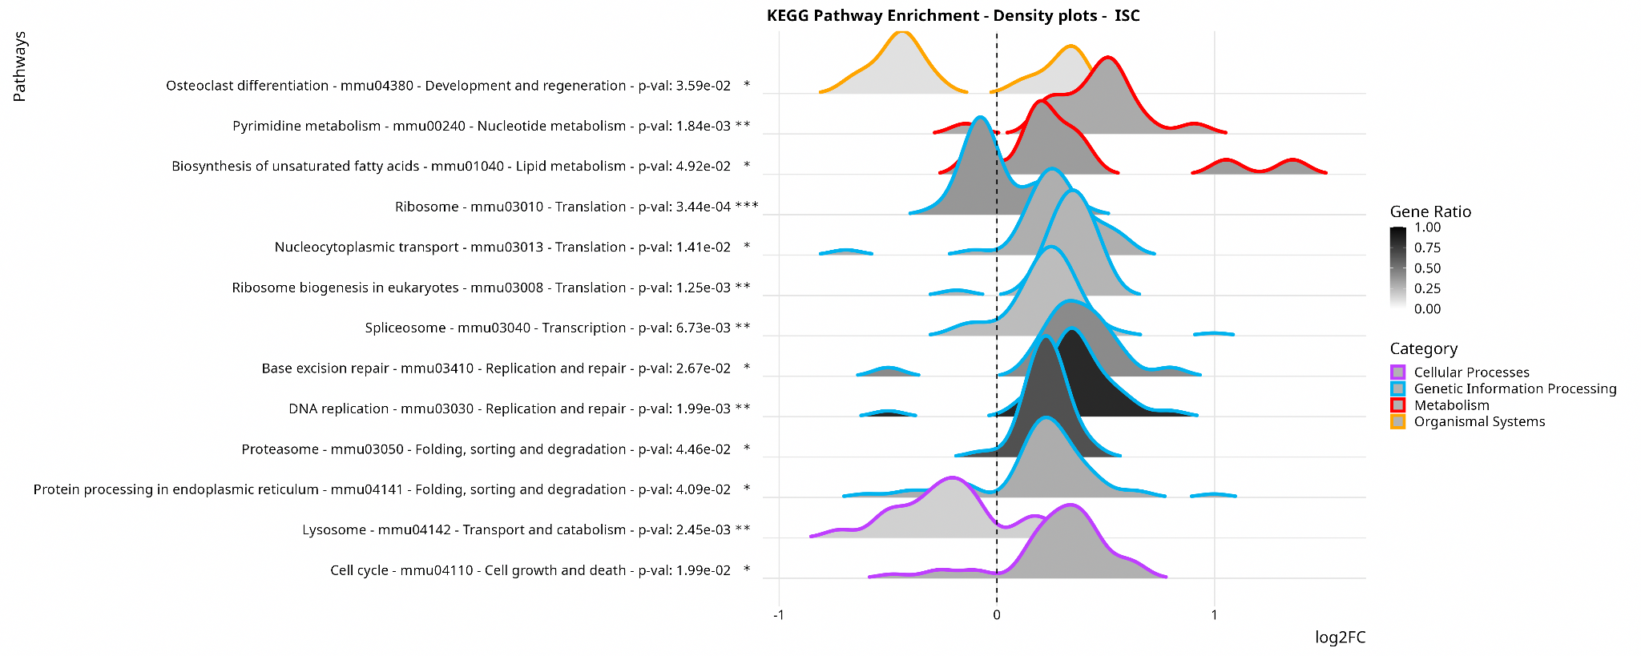

Slide 16
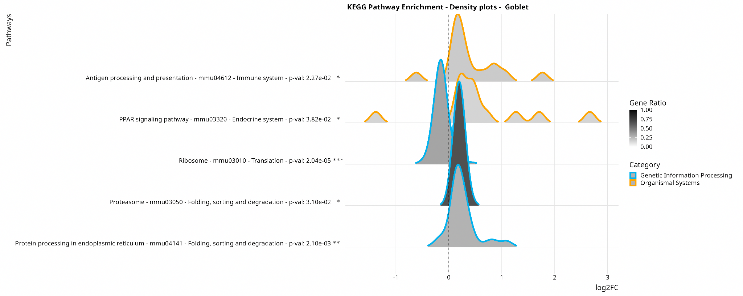

Slide 17
Metabolism Pathway Analysis

Slide 18
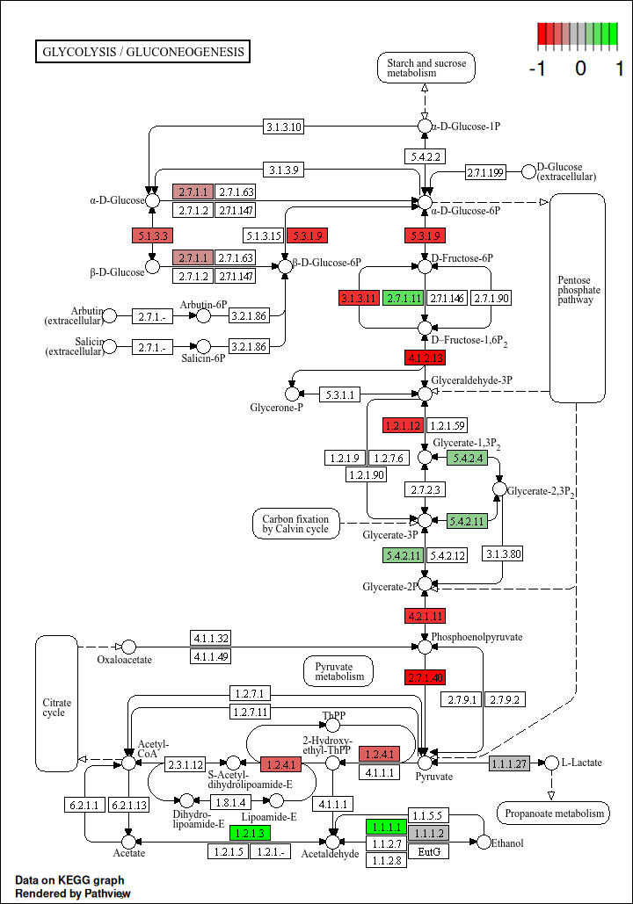
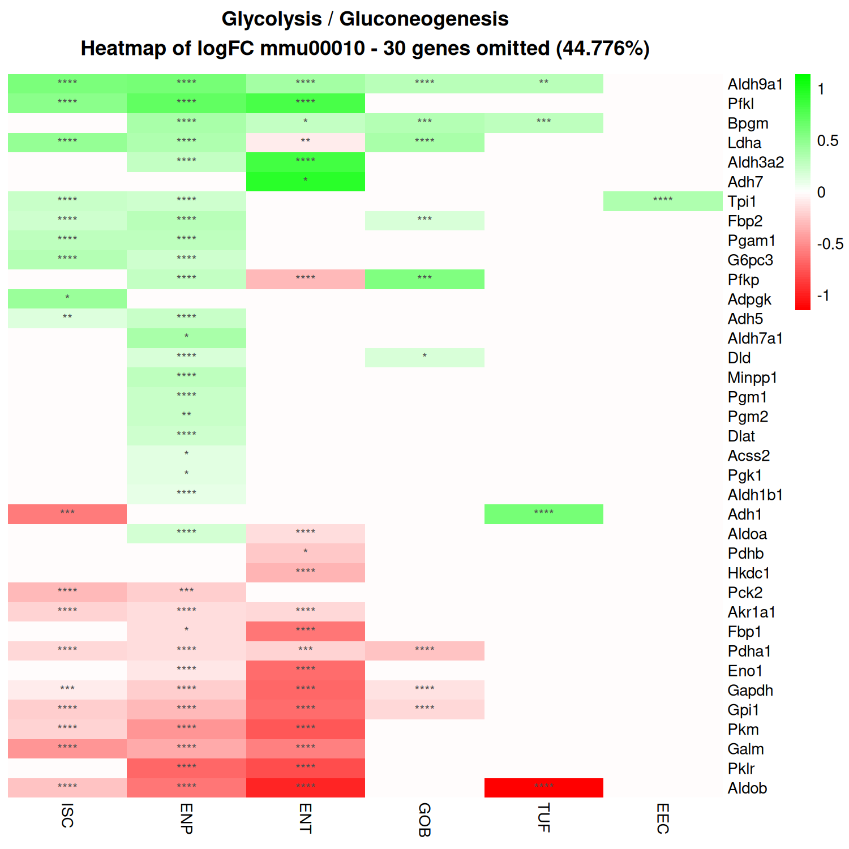
Enterocytes

Slide 19
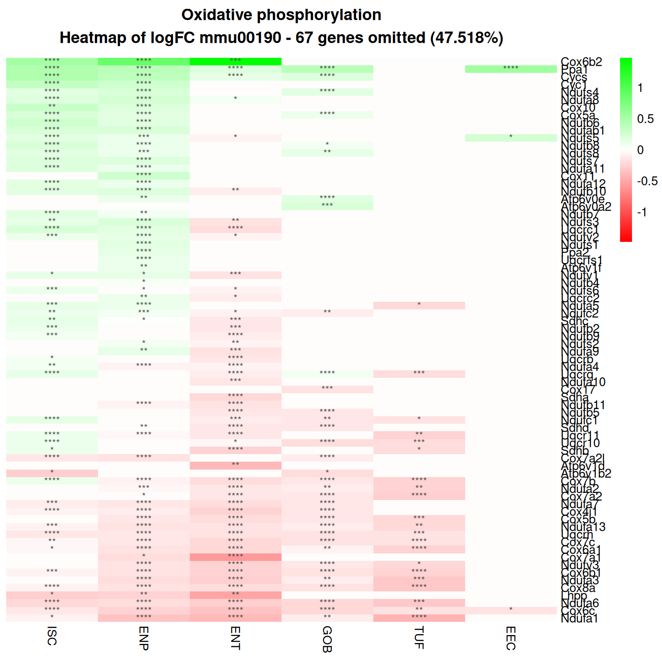
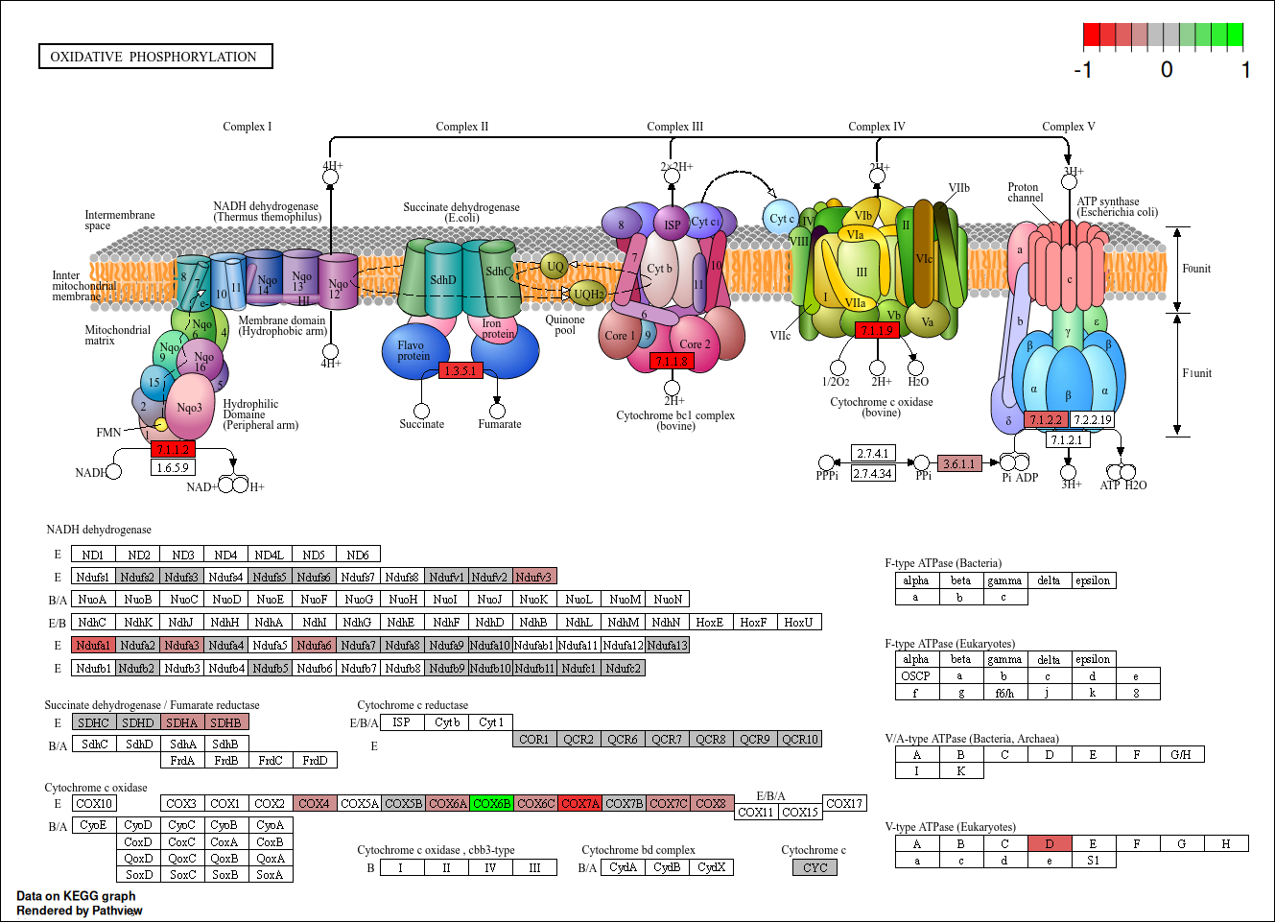
Enterocytes

Slide 20
Protein Folding/Degradation Pathway Analysis

Slide 21
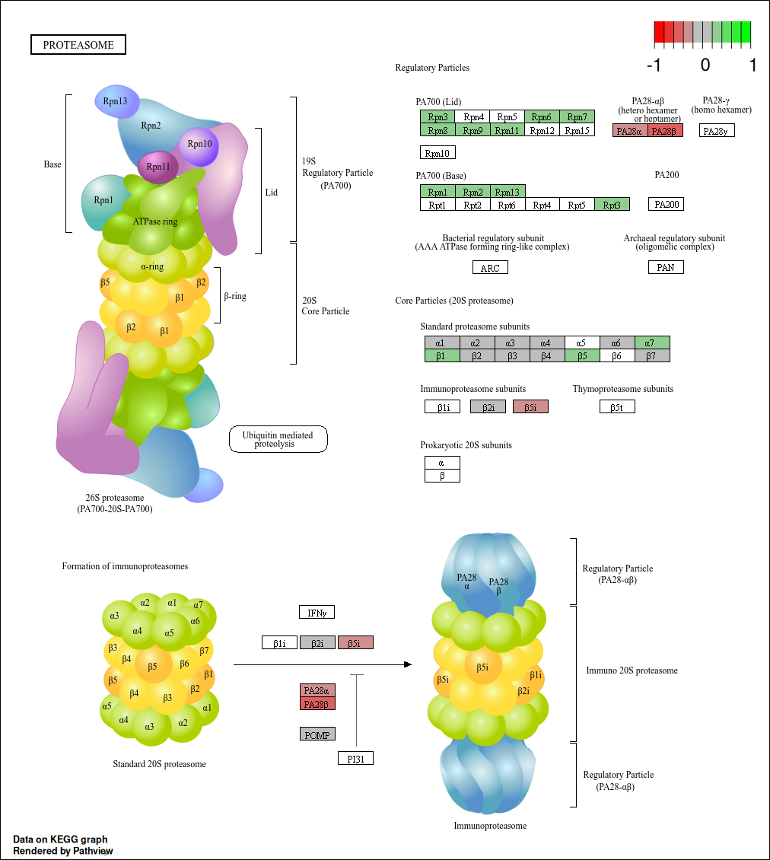
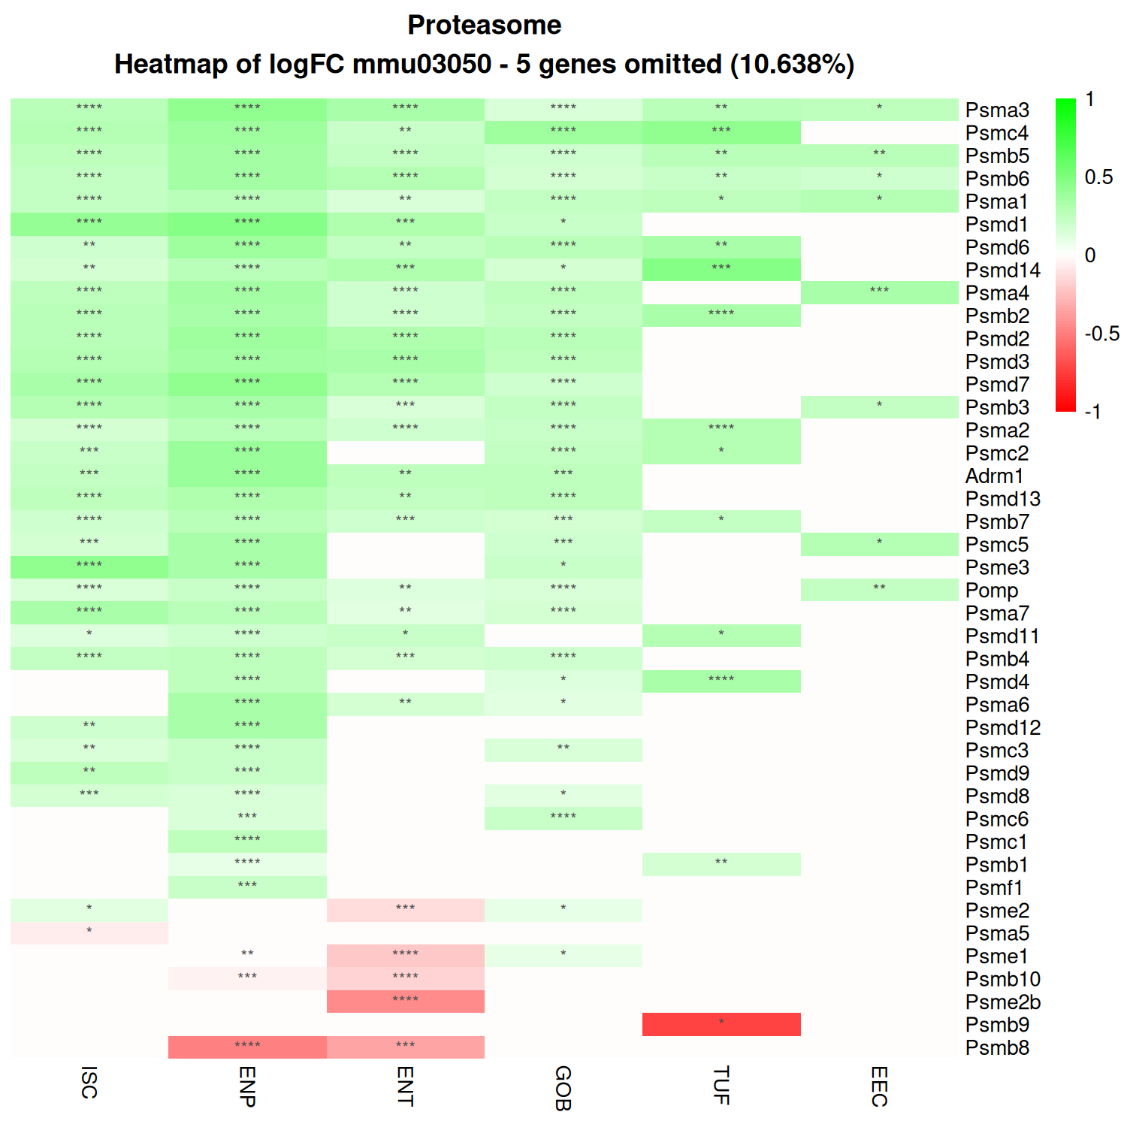
Enterocytes

Slide 22
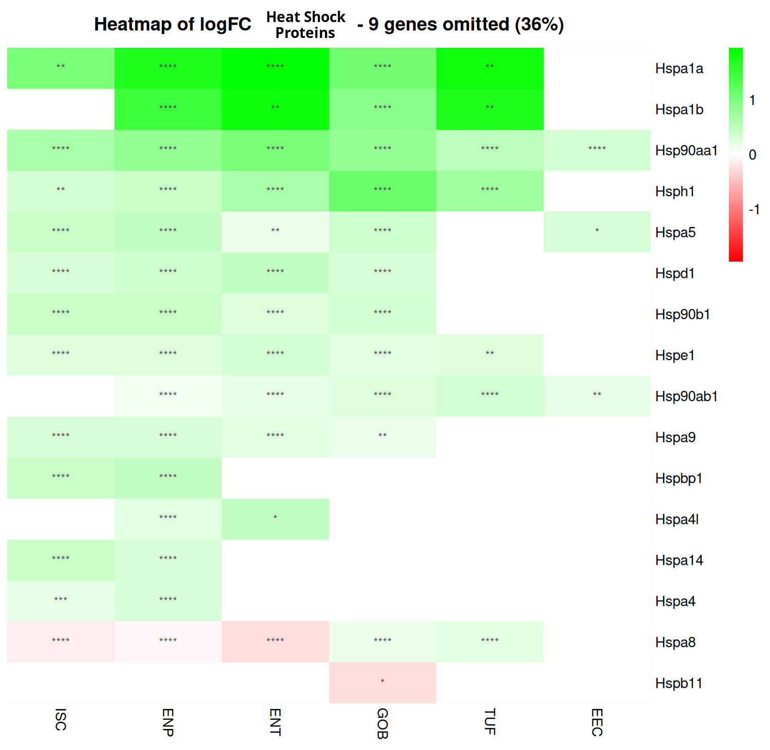

Slide 23
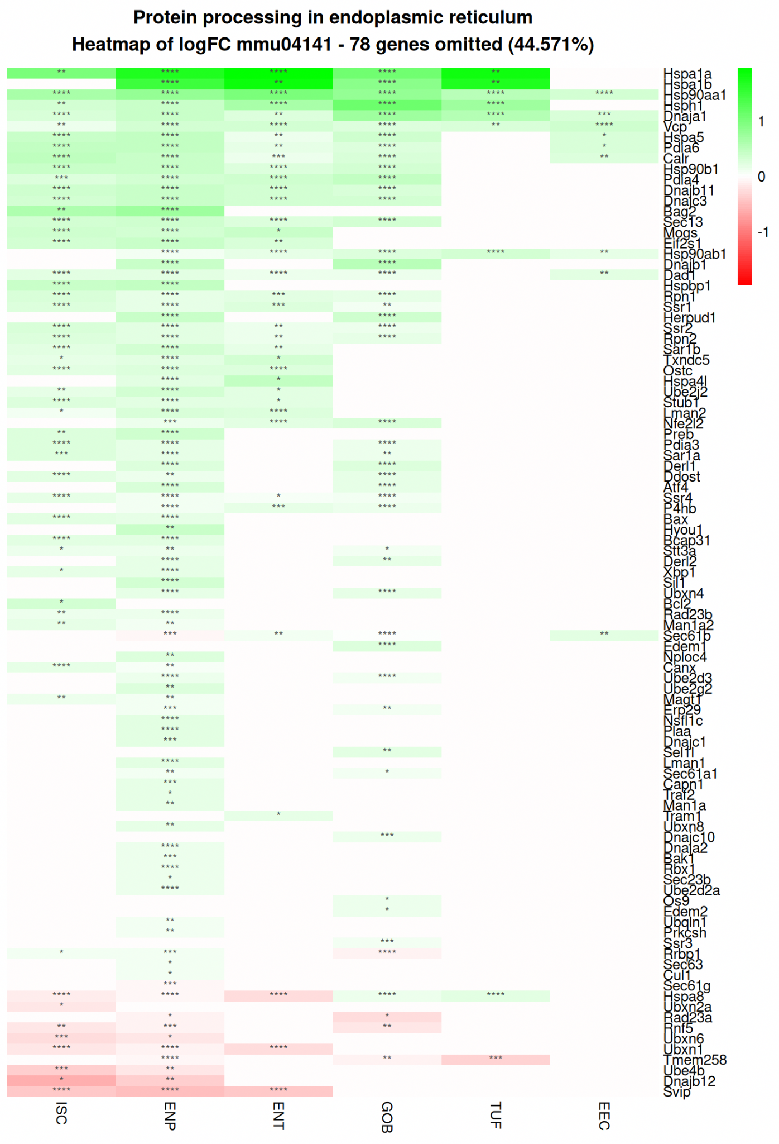
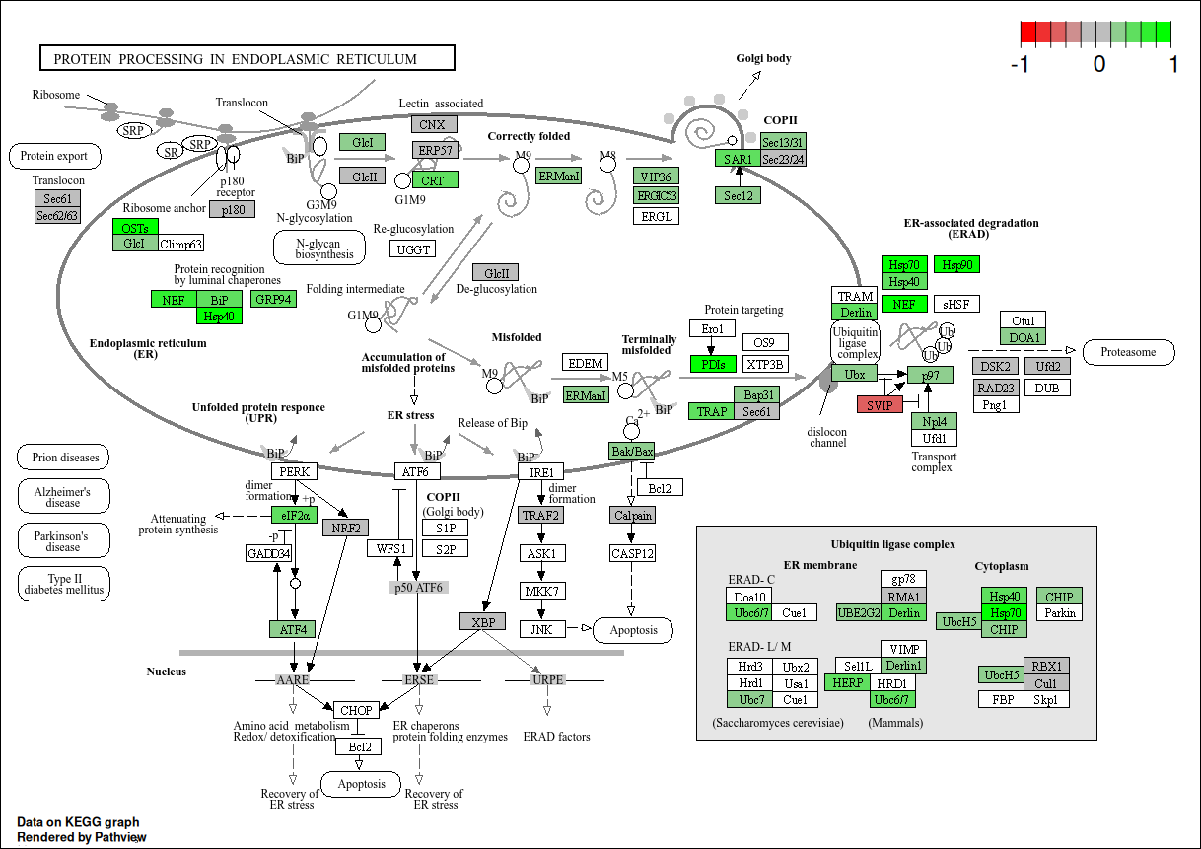
Enterocyte Progenitor

Slide 24
Barrier Function Pathway Analysis

Slide 25
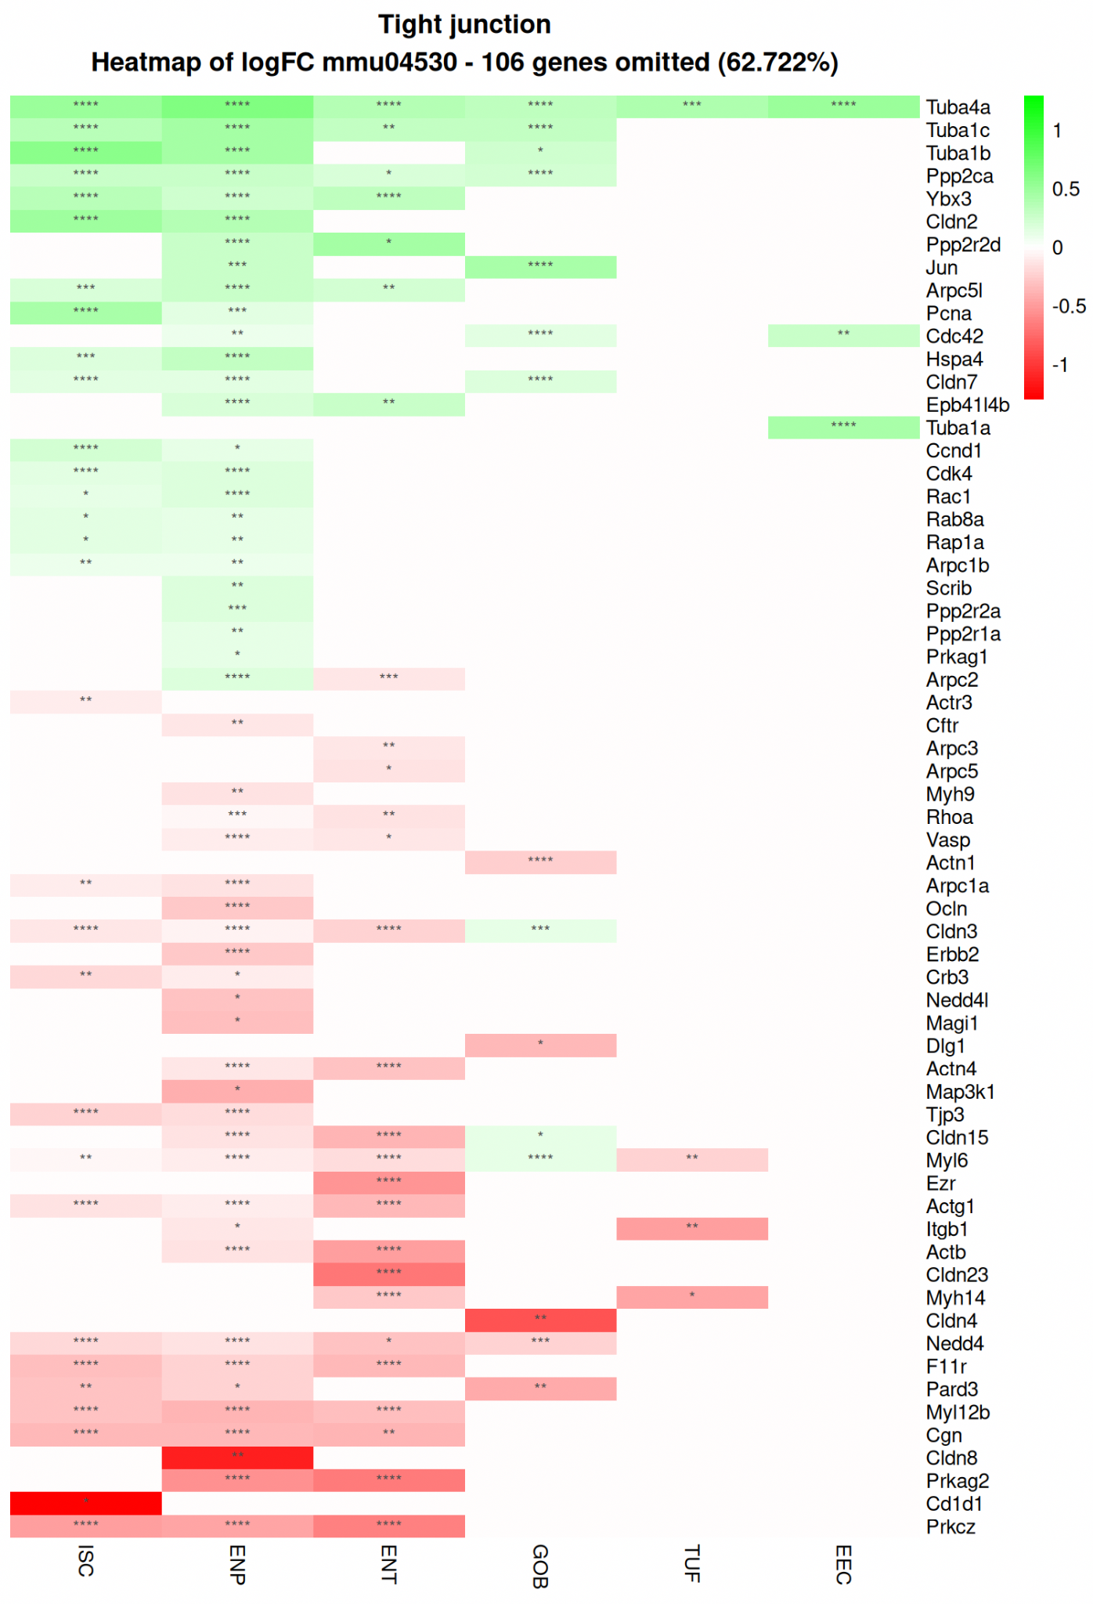
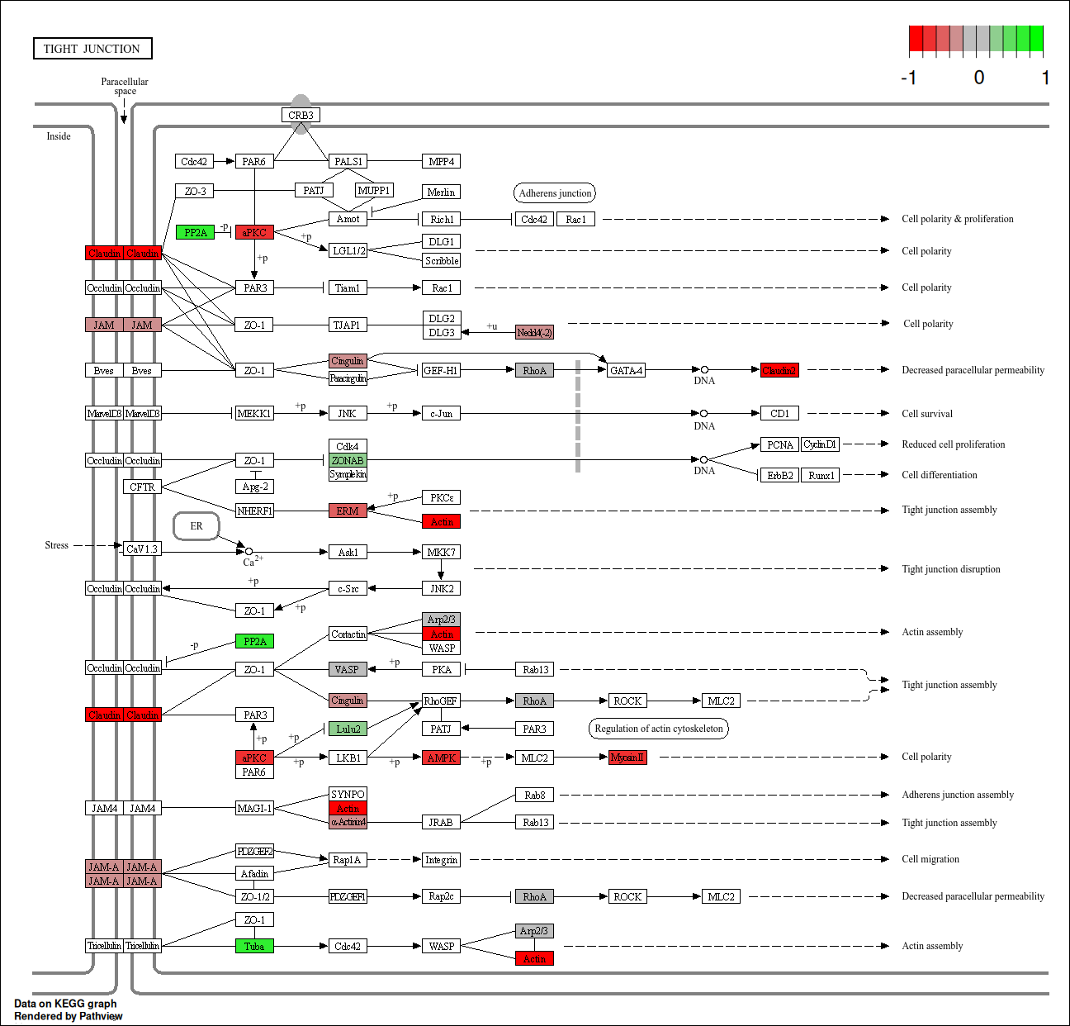
Enterocyte

Slide 26
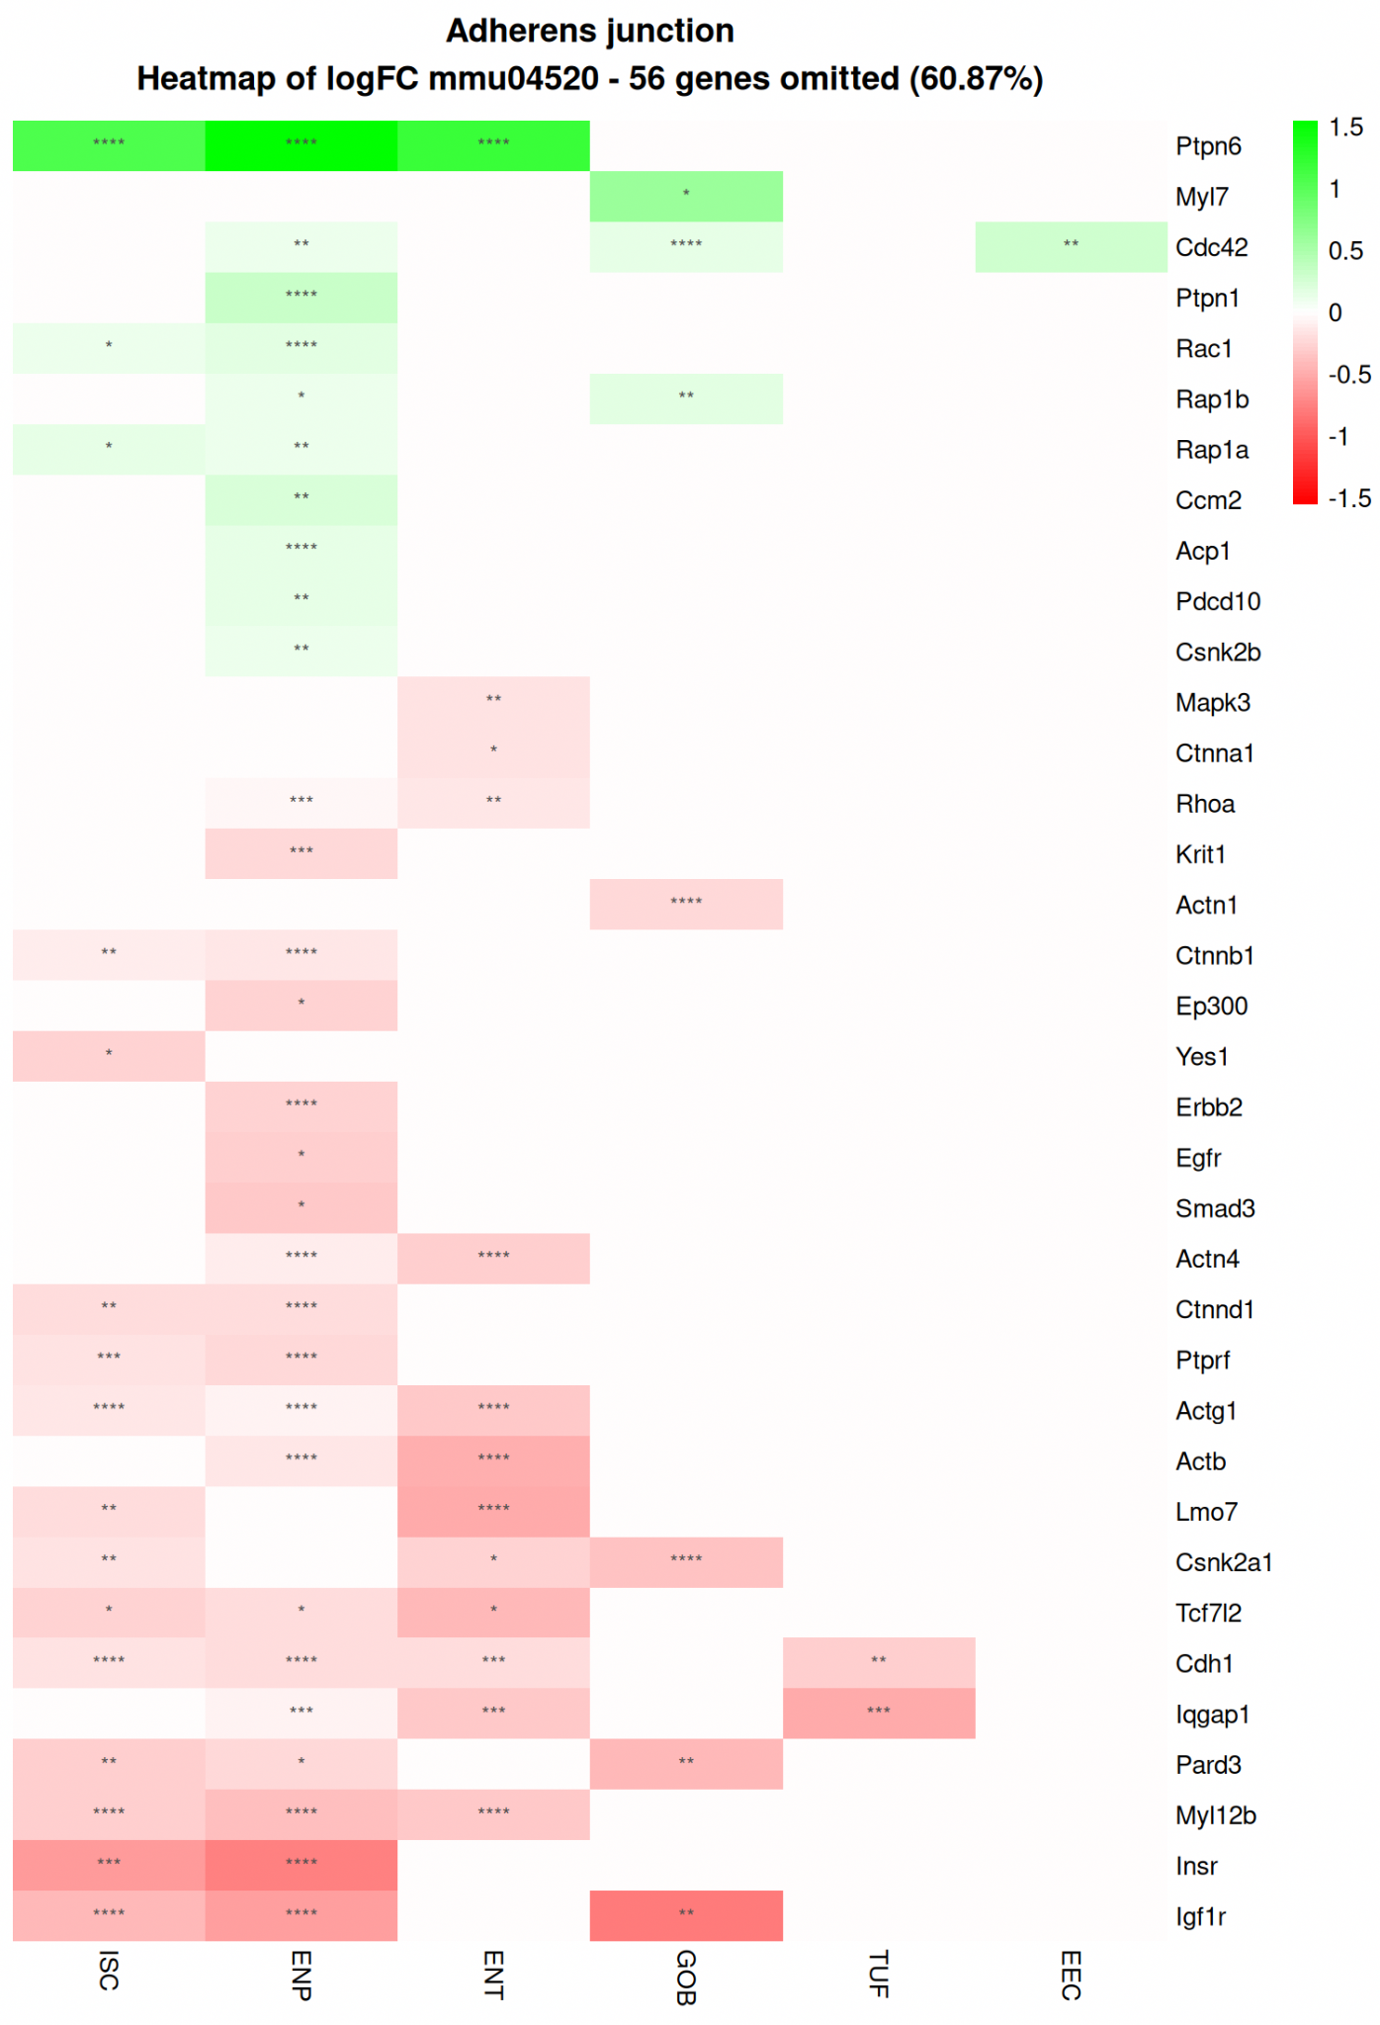
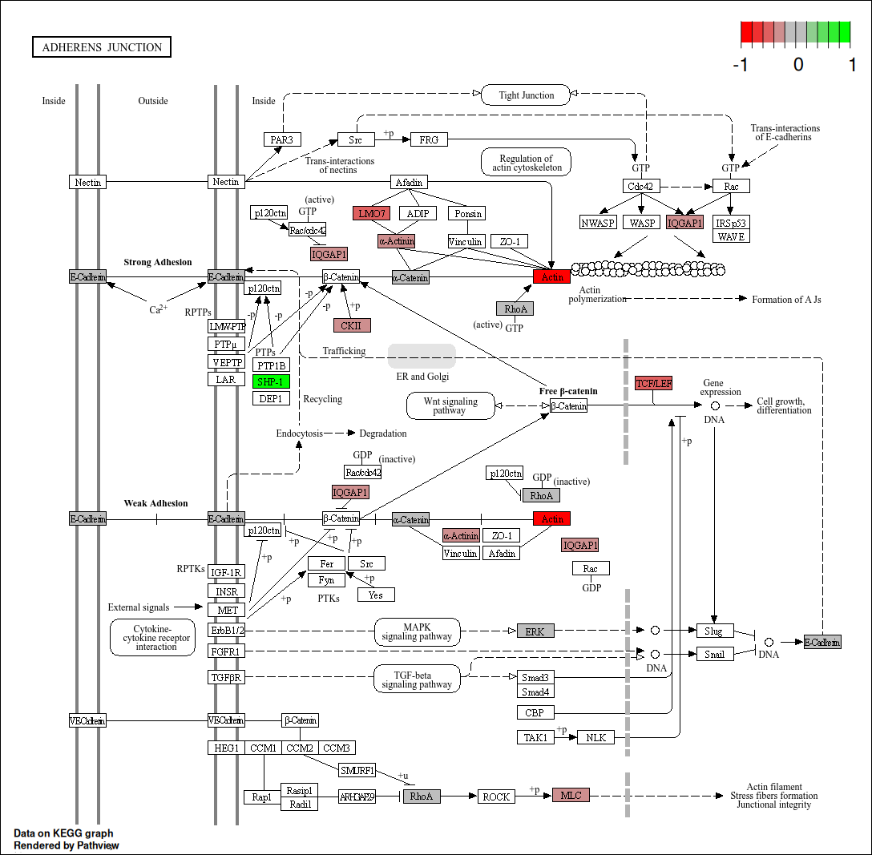
Enterocyte

Slide 27
Inflammation Pathway Analysis

Slide 28
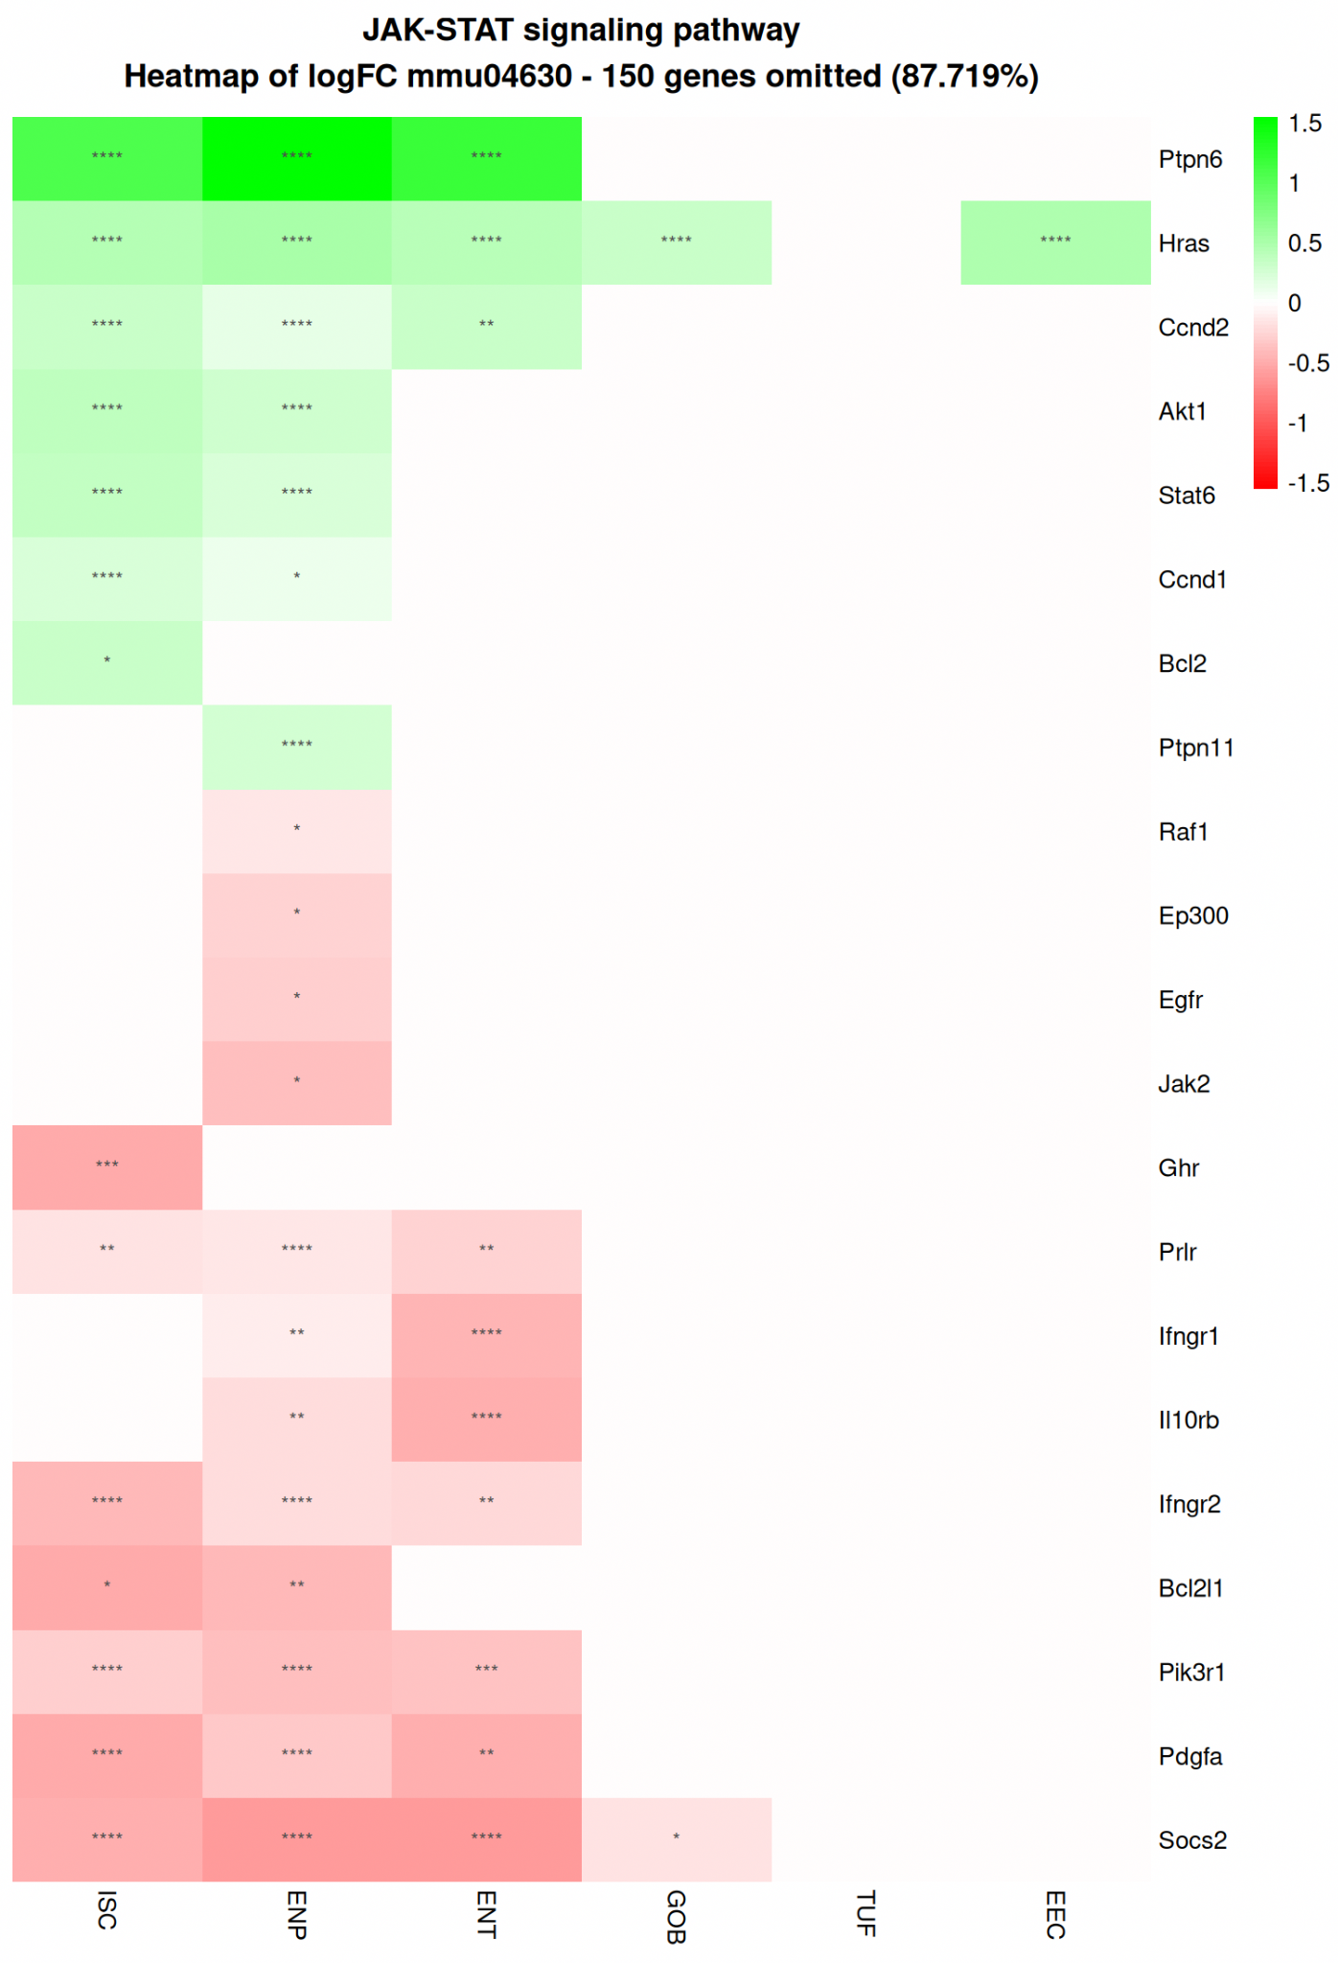
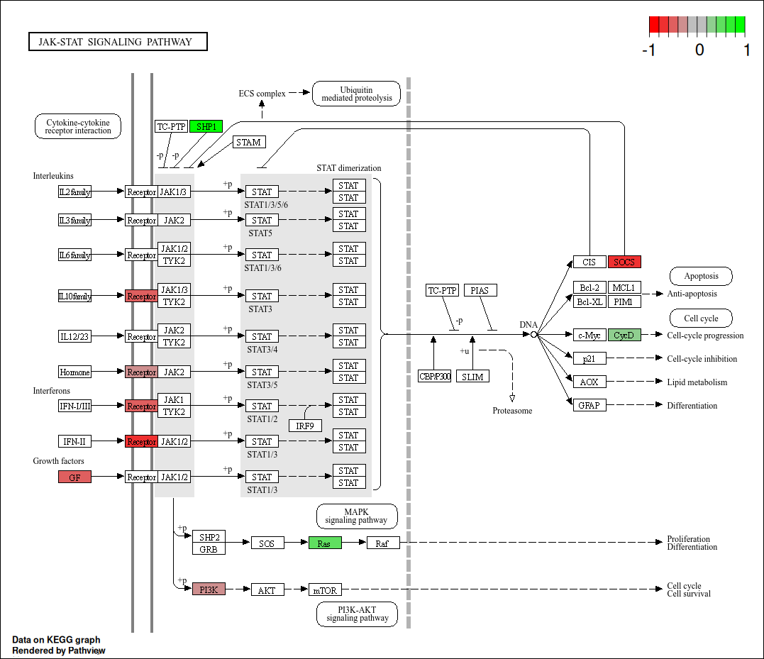
Enterocytes

Slide 29
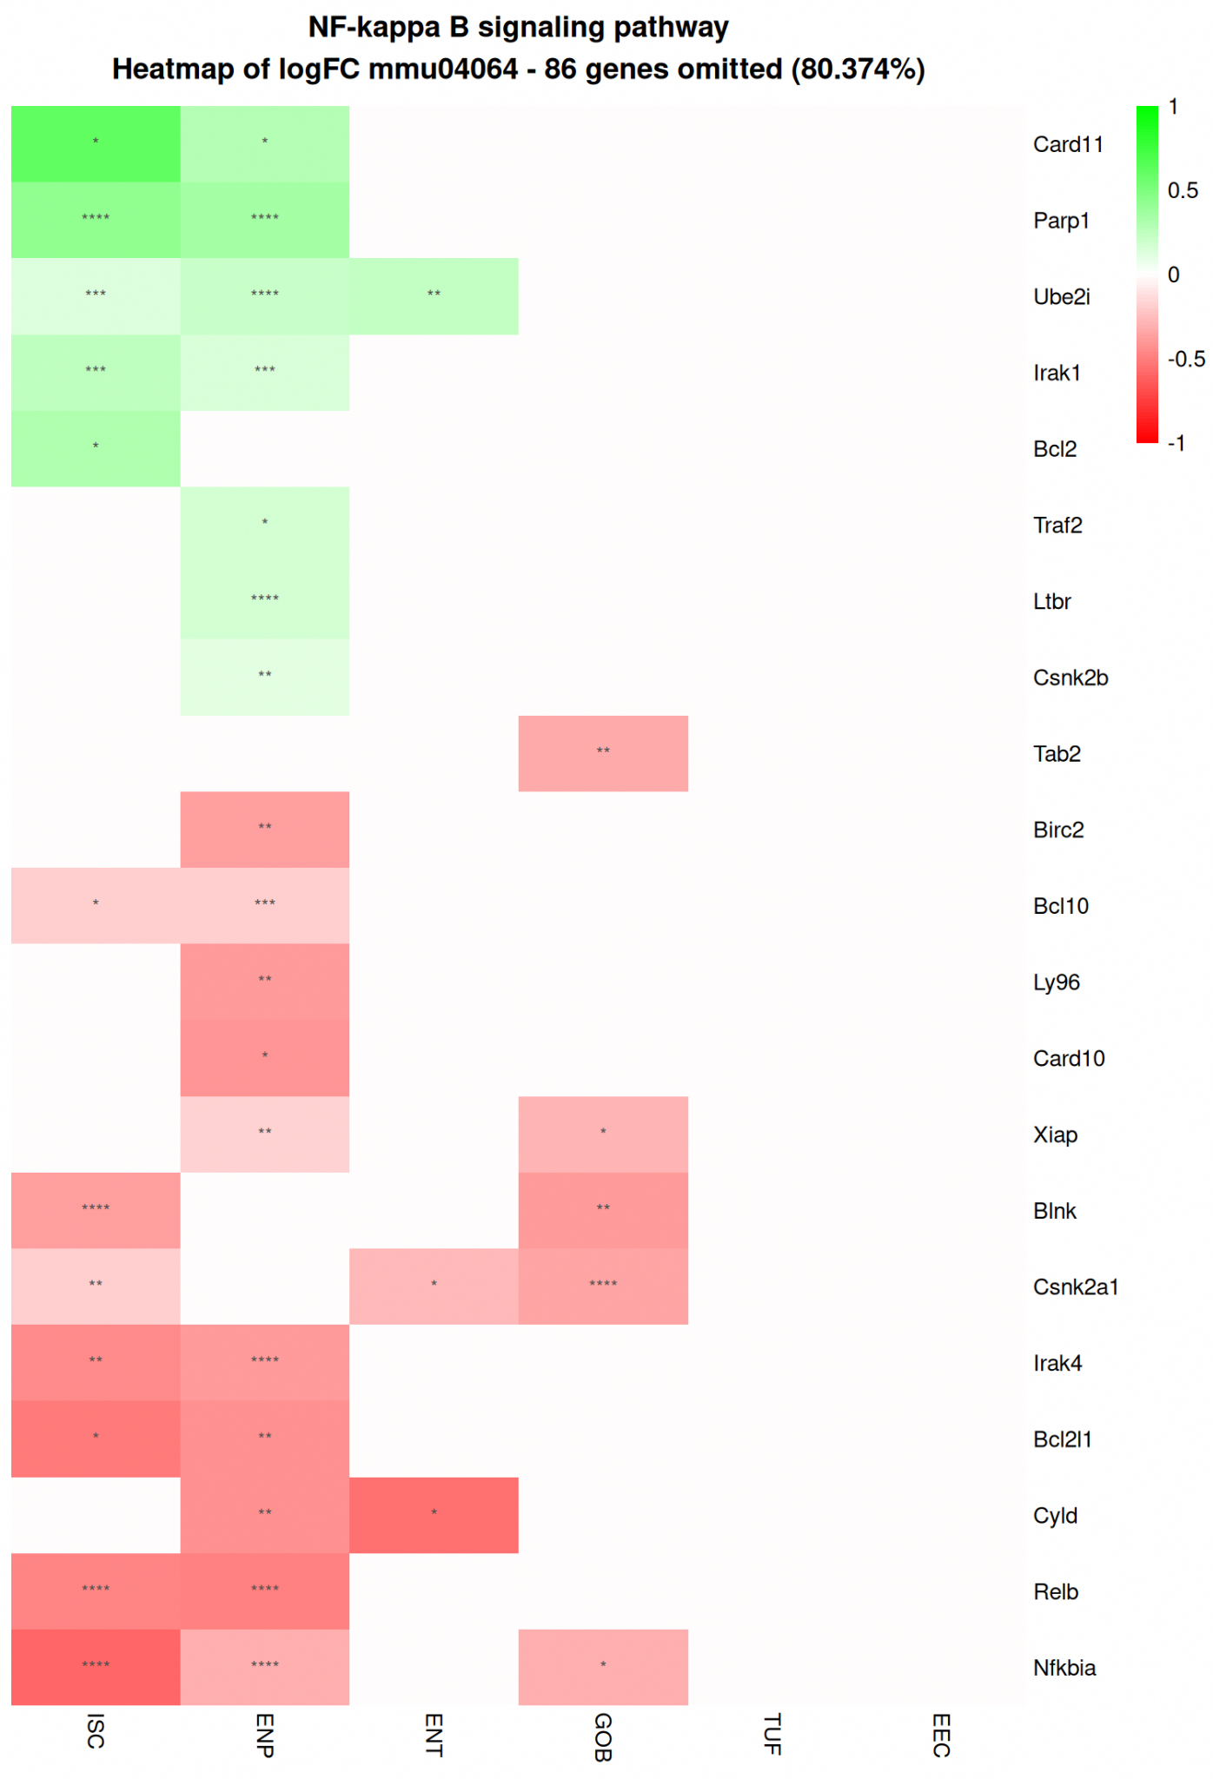
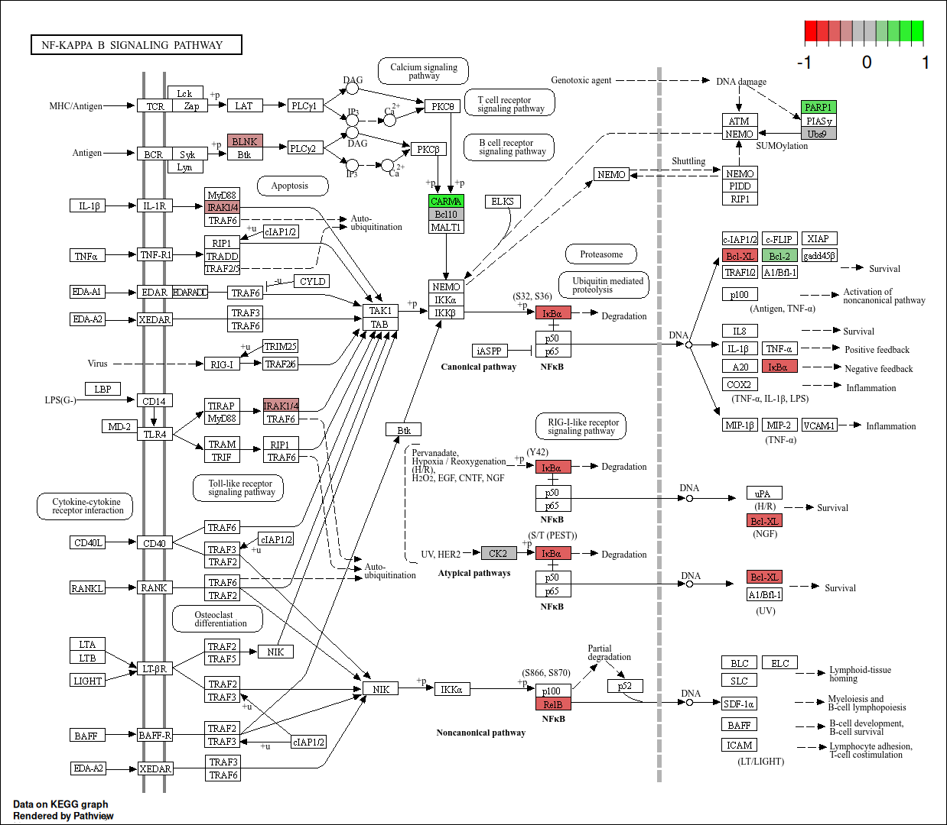
Intestinal Stem Cells

Slide 30
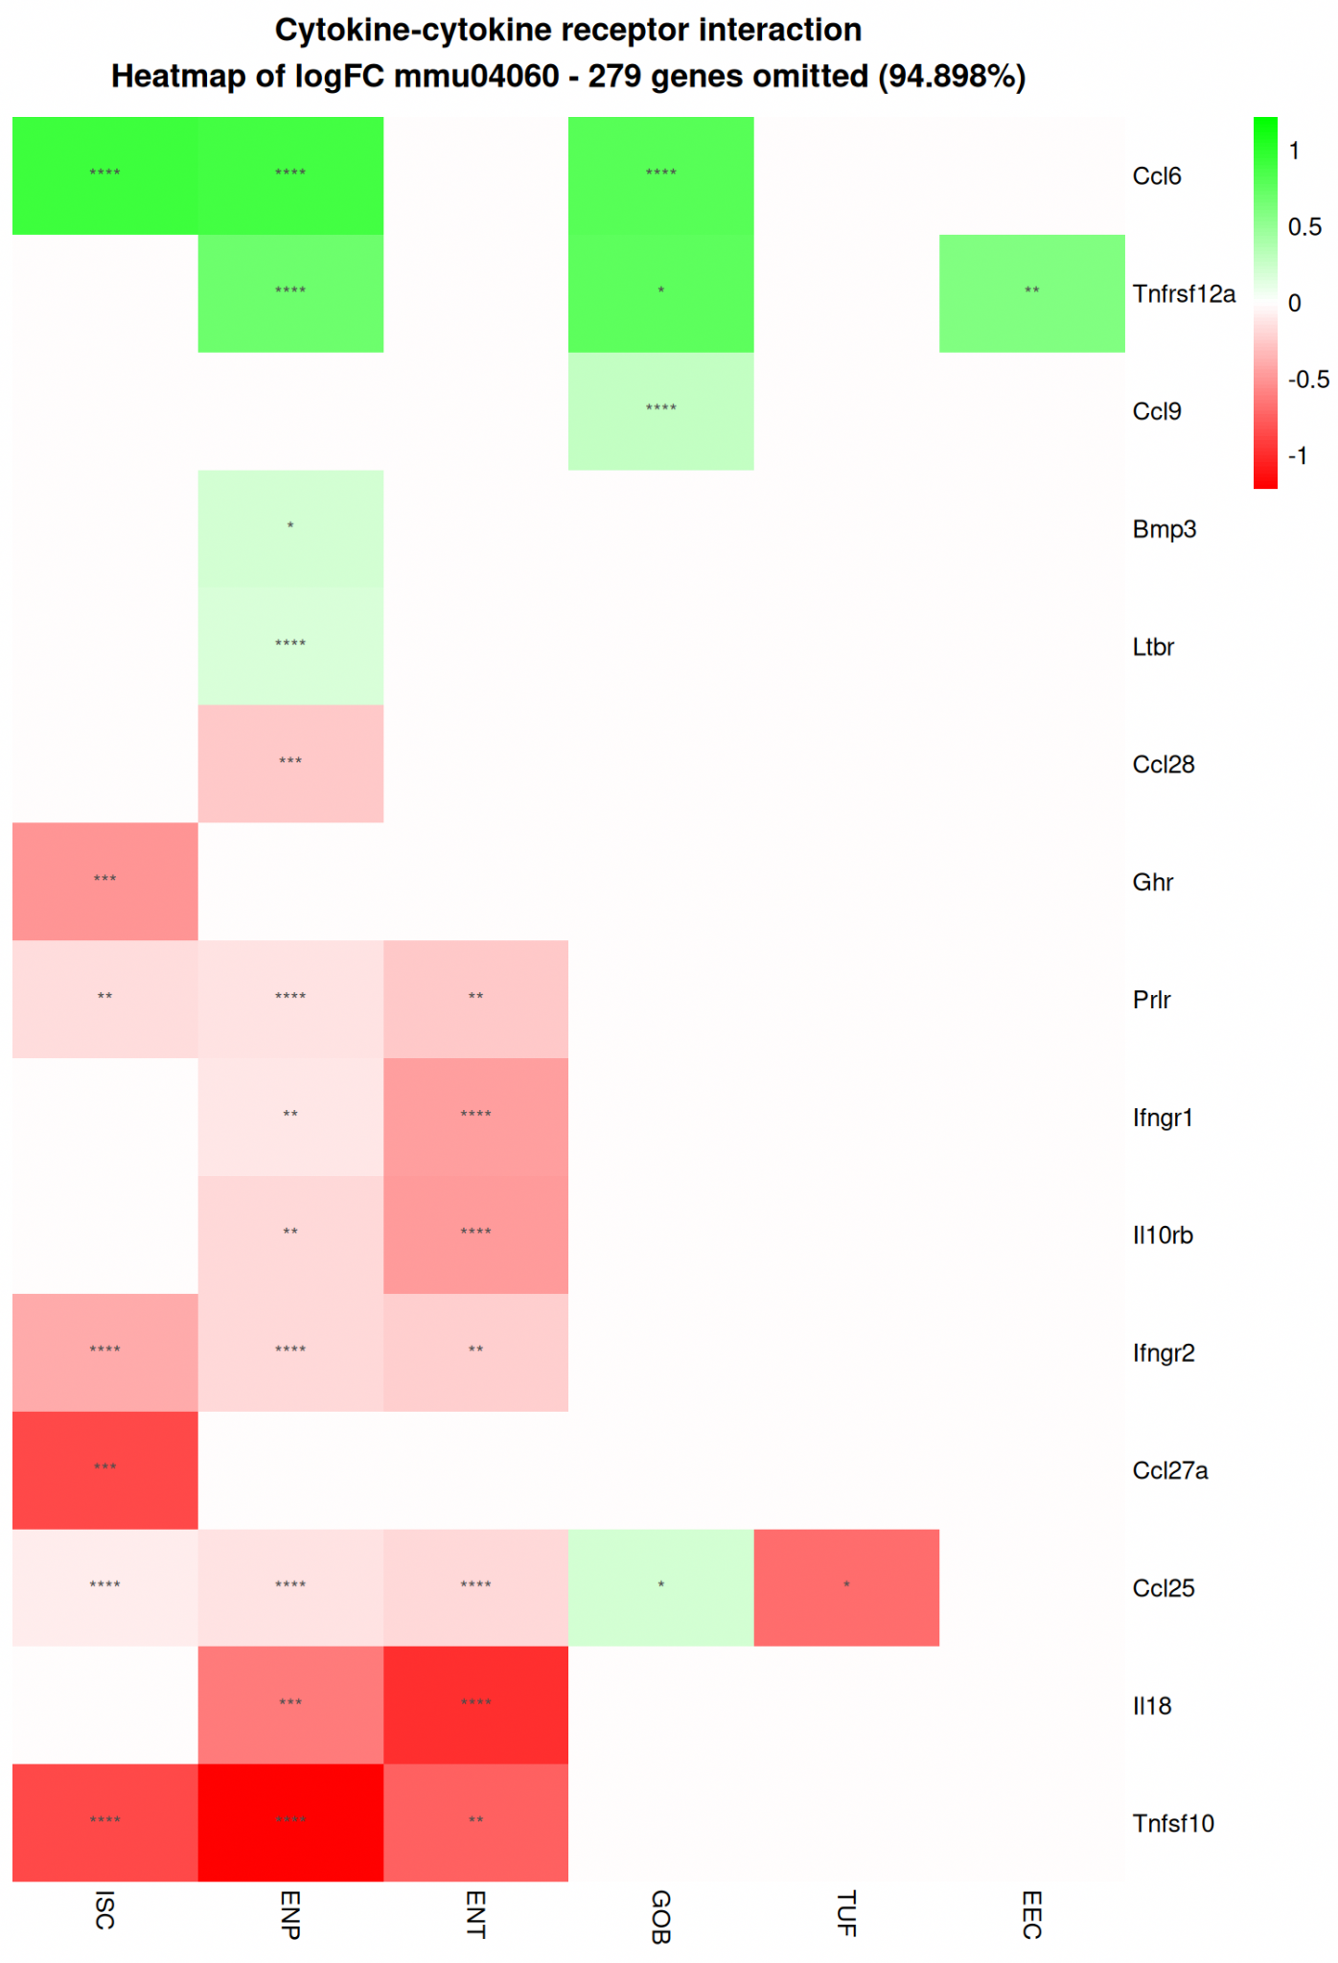
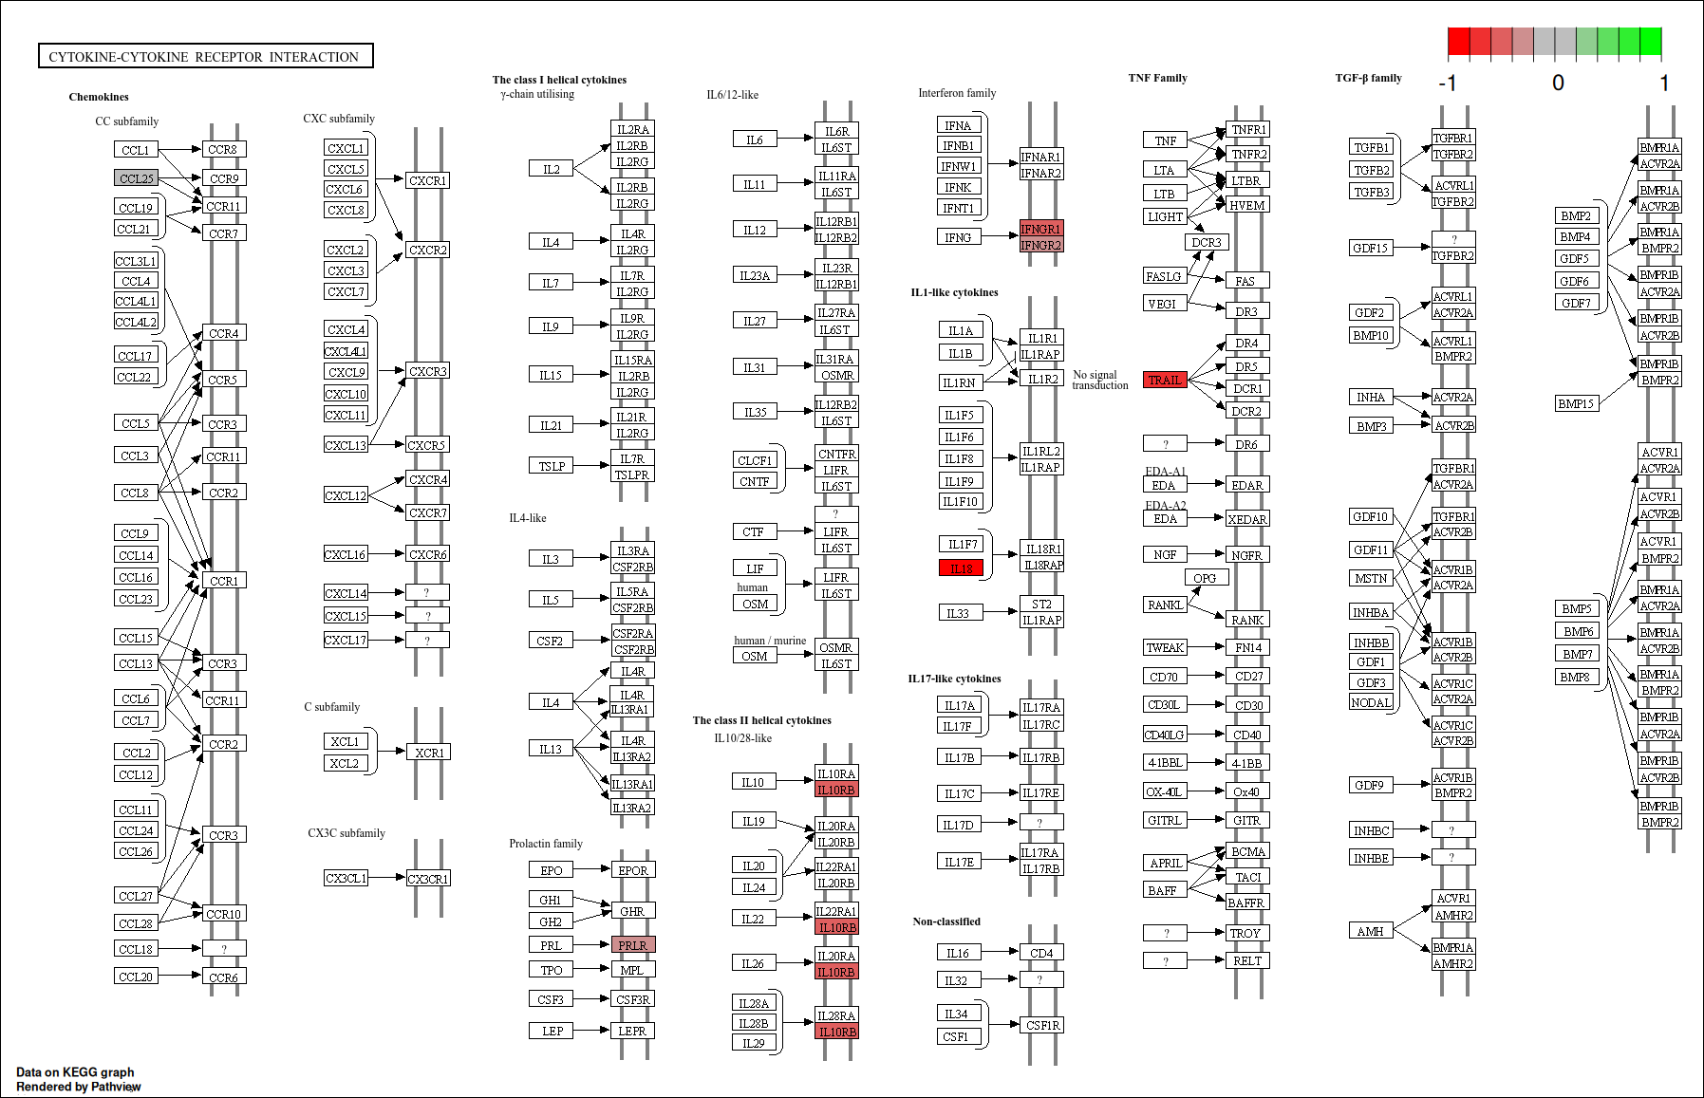
Enterocytes

Slide 31
Other Enriched Pathways

Slide 32
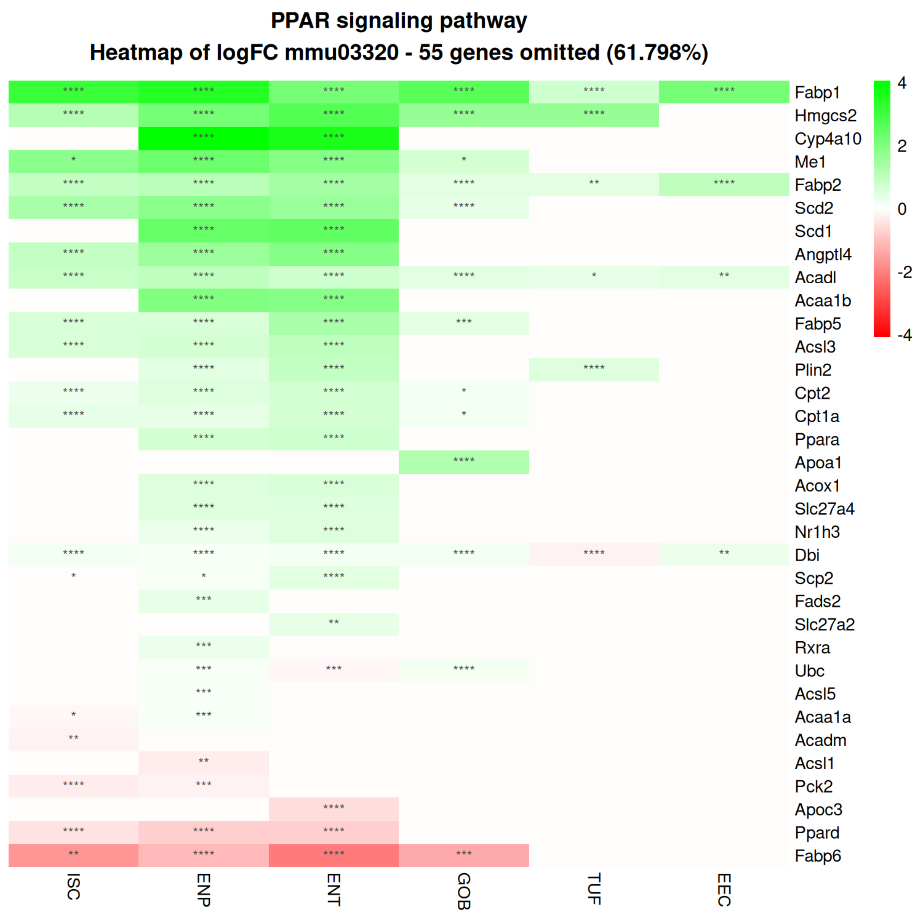
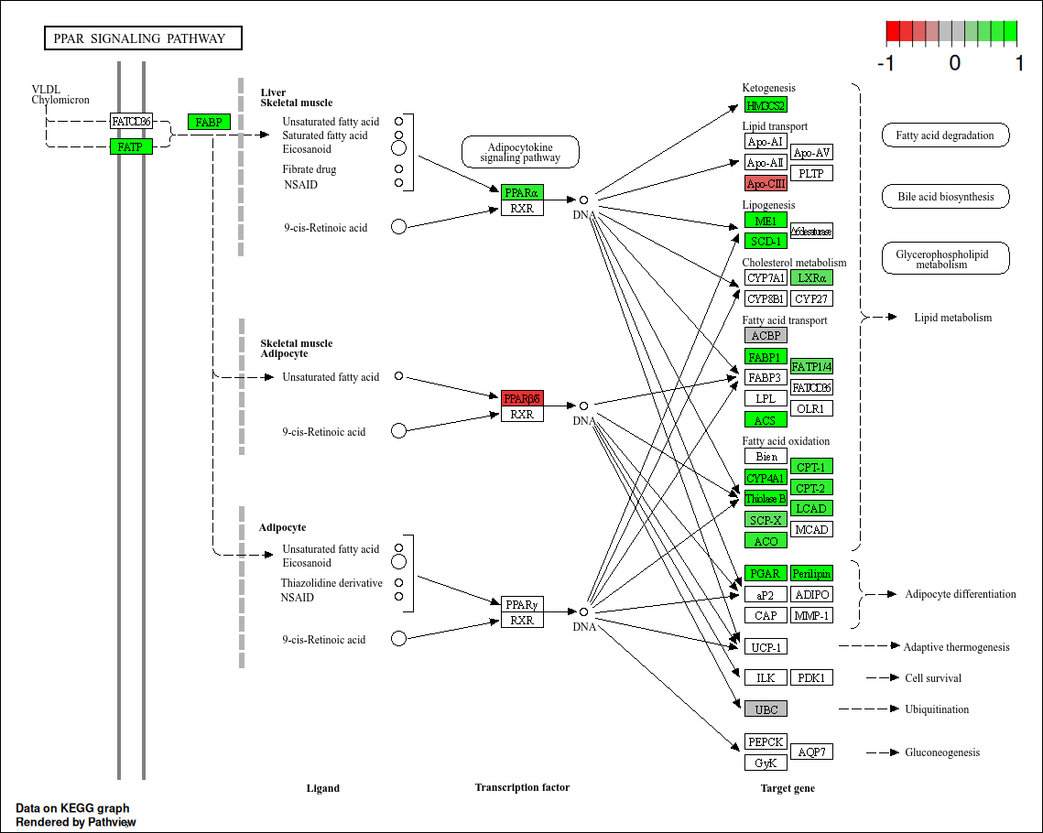

Slide 33
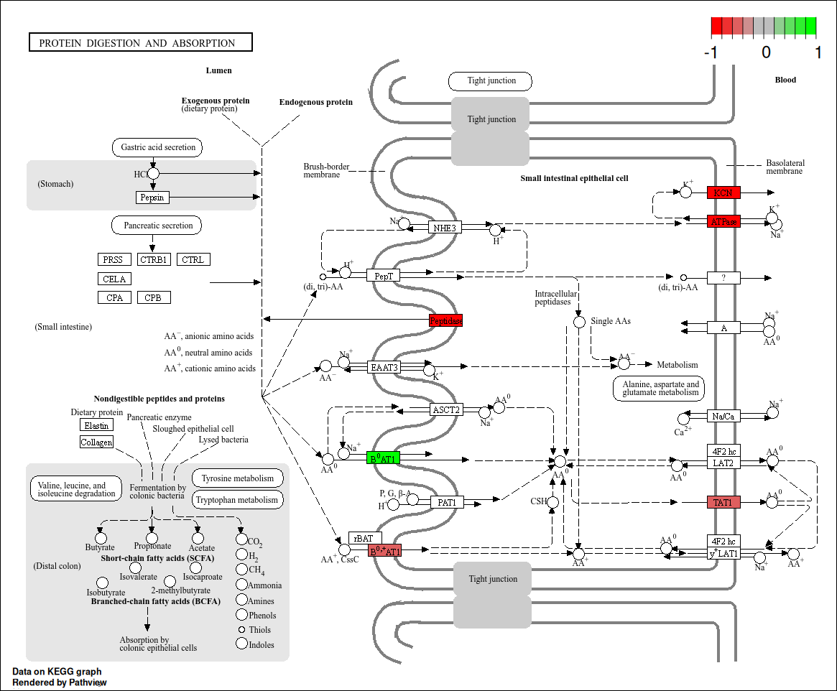
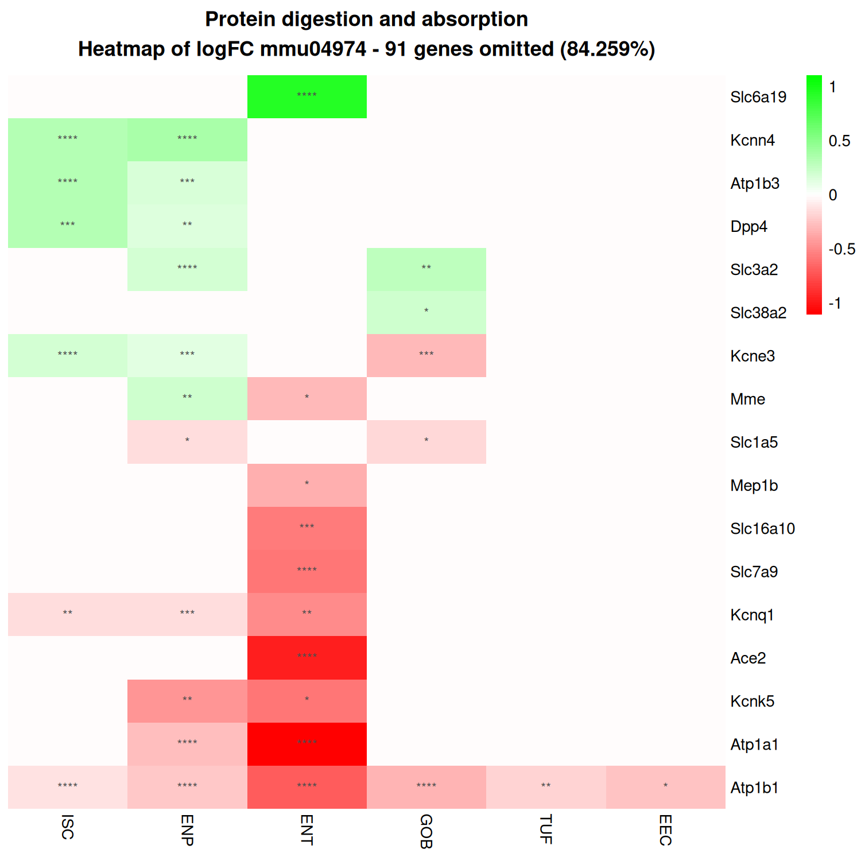

Slide 34
